Slide 1
SEMIC.EU –
Semantic Interoperability Centre Europe
XIII XBRL Workshop, Luxembourg
Notes:
Good morning to all and welcome. My name is aldo laudi and I am the project officer for SEMIC.,eu. I work for DG Informatics in a small unit which handles Interoperability Services for public administrations…

Slide 2
Agenda
What is SEMIC.EU?
Experiences on Semantic Interoperability from other sectors
[Backup] SEMIC.EU Core Person

Slide 3

SEMIC.EU – Service from DG Informatics
SEMIC.EU stands for Semantic Interoperability Centre Europe
Open platform as an online single point of contact and resource on semantic interoperability
Collaborative tool permitting the development, sharing and reuse of semantic assets between European public administrations
Service Centre for European administrations and eGovernment projects
  Online – www.semic.eu
  Offline – Contact with the semic team.
24 November, 2010
Notes:
READ THE ABOVE…
But most of all it is not a project. It is a service.. And how can this service assist administrations?

Slide 4
Layers of Interoperability (Source: European Interoperability Framework)
Organisation A
Organisation B
Legal
Data
Organisational
Data
Semantical / Syntactical
Technical
24/11/10

Slide 5
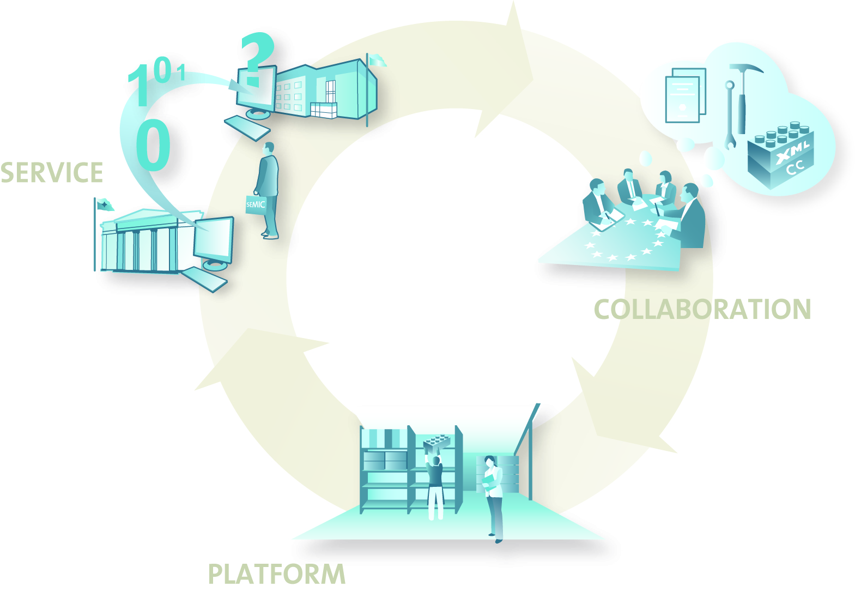
What is SEMIC.EU ?
Service
Coaching for development and reuse of interoperability assets
Collaboration
Technical community for pan-European data exchange
Repository
Provision of quality-assured semantic interoperability solutions

Slide 6
SEMIC.EU Roadmap – 2007 - ??

Slide 7

SEMIC.EU: collaboration platform
> 500 assets
> 1.200 users
> 90 Projects
8 Communities
Sustainable Service for eGovernment
Community
Management
Partner for eGovernment
Service point for interoperability
Knowledge base for semantics

Slide 8
SEMIC.EU – Repository of artefact types
Schema
Code Lists
Vocabularies
Glossaries
Ontologies
Projects
PRTR
Pollutant Release and Transfer Register
ISCO 08
Classification of Occupations
EUROVOC thesaurus
Federating thesauruses
DIFI.NO
Glossary of Public administration
Norway
AGROVOC
Food & Agriculture Organisation,
(FAO) Rome
Assets
Data flow Interface (XML3)
EC Occupation (ISCO 08)
Pilot
implementations
Under
development
Projects Ontology
Methodology
Core Components
UML
SEMIC.EU
Code List Concept
SKOS
W3C Methodology
SEMIC.EU
Asset development
Assistant
Matching / Mapping
Tools
XGenerator
UML2XSD
(Collaboration)
Code List Service Management
(Collaboration)
OpenCalais
EPOC IV Software
NeOn
Networked Ontology Toolkit
Notes:
8

Slide 9





































































SEMIC.EU – Network of European Collaboration

Slide 10
Benefit from SEMIC.EU Coaching service
Call for coaching by the SEMIC.EU interoperability team
Call for comments from the SEMIC.EU network of national experts
Get feedback to your concept from other community members
Notes:
Apart from online services, SEMIC.eu offers also offline service, mainly coaching, which includes things like/:
Assistance in the development of assets or their re-use
launching a public consultation on a particular issue etc etc
Bringing stakeholders together to facilitate discussions and collaborate on semantic interoperability…

Slide 11
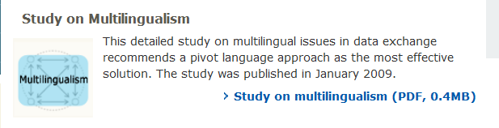
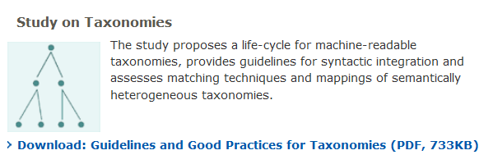
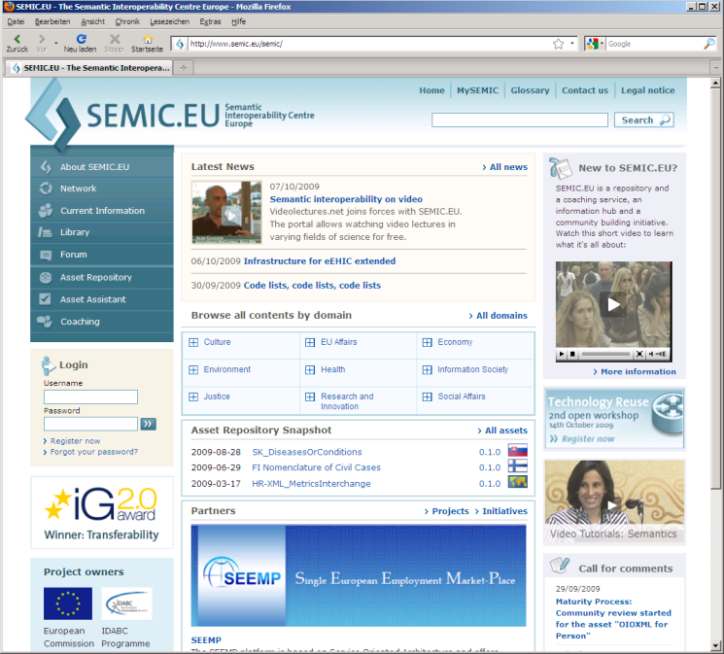
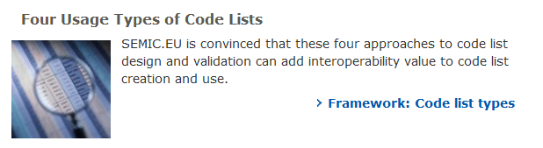
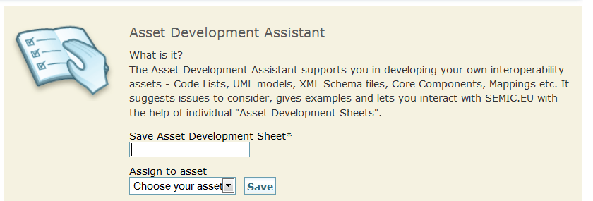
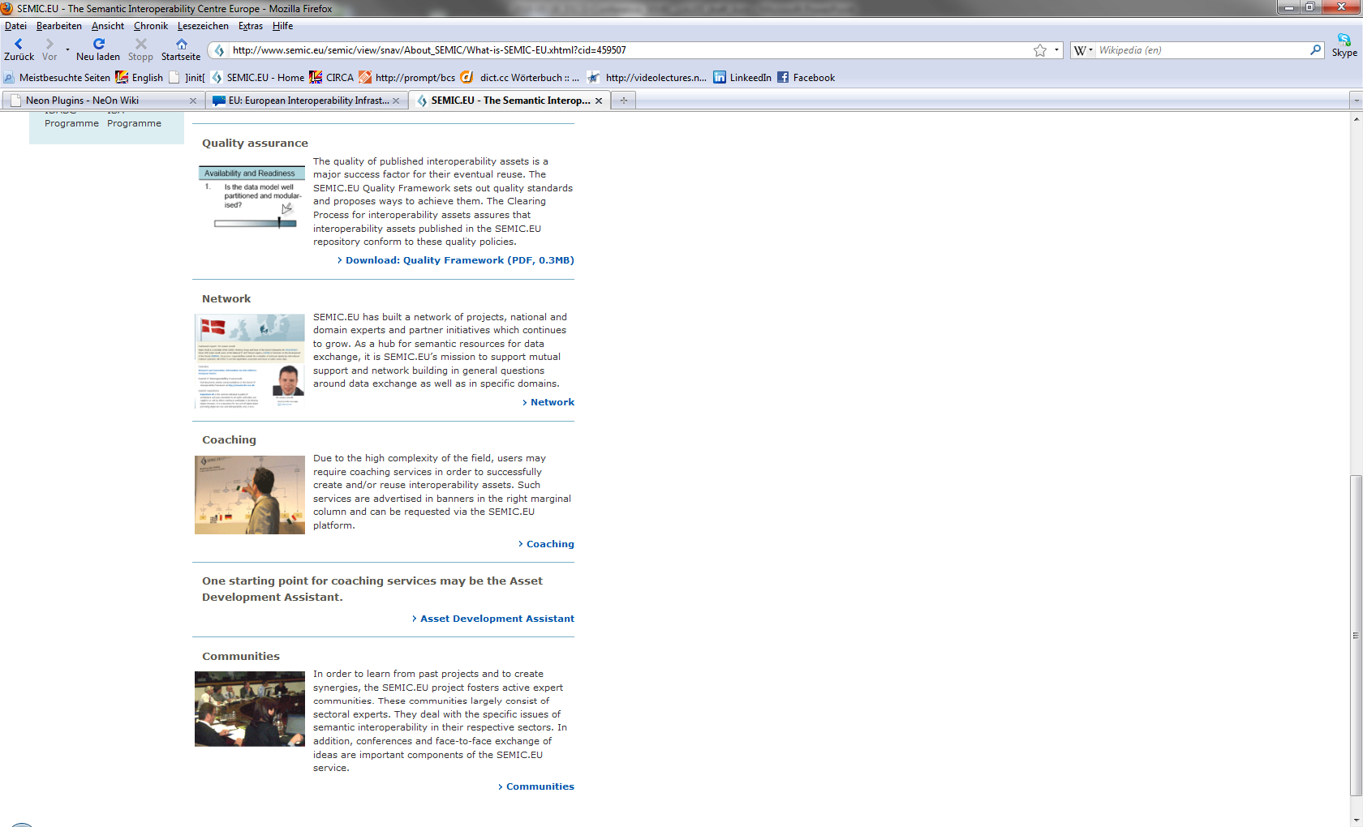
Collaboration and Reuse in the SEMIC.EU World
Notes:
Collaboration in terms of :
Development of methodologies and best practices
Discussion of particular assets and harmonisation of such assets
creation of communities sector specific and border specific

Slide 12
SEMIC.EU and XBRL

Slide 13
SEMIC.EU and XBRL
XBRL Europe Coordinator participated in SEMIC.EU Workshop
FINREP and COREP registered as assets in repository
FINREP and COREP passed the maturity process
…

Slide 14
Level of Interoperability
1.
Identification
Data can be identified
2.
Information
Agreement on common messages
3.
Integration
Data can be read from other registers
4.
Interaction
Transaction (read & write)

Slide 15
Level of Interoperability
Identification
Information
Integration
Interaction
Identifying characteristics
Common message format
Federated searches, read-only
Transactions
1.
2.
3.
4.

Slide 16
Experiences from other sectors

Slide 17
Frequent issues
How to deal with different granularities in data exchange?
Maintenance processes
  Change management
  Release management
Persistent URI‘s and Namespaces
Naming and Design Rules
Multilingualism. Pluralism ‚Heterogenity

Slide 18
Frequent issues
Hyperonyms, Hyponyms and Synonyms
Ontologies or Name-Value pairs for Information Integration?
Feasibility of Mappings
Loss of information
How much structure, how much syntax, how much semantics?
Modularisation of assets
Reuse of assets

Slide 19
Frequent issues
Separation of concerns (presentation, content, technical details)
Ongoing migration of huge data bases (DTD->XSD->SKOS->?)
Domain specific data exchange formats
vs. RDF / Linked open data with domain specific vocabularies
Quality / Credibility of data
Complexity of legal interoperability

Slide 20
Frequent issues
Visualisation
Tool support for handling semantic assets
Federation of repositories
Asset Description Metadata Format
Test suites and test beds
And so on….

Slide 21
Contact: sebastian.sklarss@init.de
Thank you for your attention!
Notes:
Thank you

Slide 22
What is the SEMIC.EU
Core Person?

Slide 23
List of 60 Co-Authors
Segun Alayande, British Airports Authority, Great Britain; Marko Ambroz, Slovene Government, Slovenia; Adam Arndt, National IT and Telecom Agency - Ministry of Science, Denmark; Joseph Azzopardi, Government of Malta, Malta; Francisco Barbedo, Ministery of Culture, Portugal; Mohamed Ben Said, University Paris Descartes, France; Fineke Beukema, Ministry of Justice, Netherlands; Lyubo Blagoev, United Software Writers, Bulgaria; Giuliana Bonello, CSI Piemonte, Italy; Claudio Bosco, City of Cittadella, Italy; Heath Bunting, Irational, United Kingdom; Mustafa Canli, Turksat, Turkey; Anna Cavallo, CSI Piemonte, Italy; Marco Combetto, Informatica Trentina , Italy; Noel Cuschieri, Government of Malta, Malta; Michal Danilak, LYNX, Slovakia; Ralph Fiergolla, DG DIGIT, EC; Jörn Freiheit, CSC, Germany; Mark Fresko, Inforesight, United Kingdom; Monica Ghecea, Bromotion, Belgium; Juan Goni, Fatronic-Tecnalia, Spain; Eduardo Alejandro Gonzalez Blanco, Gonblan Consultores S.L.P., Spain; Alejandro Gonzalez San Roman, Accenture, Spain; Jan Goossenaerts, Pragmeta Knowledge Clout, Belgium; Simon Grant, Center for Educational Technology and Interoperability Standards, United Kingdom; Riccardo Grosso, CSI Piemonte, Italy; Heimo Hänninen, Tieto, Finland; Bart Hanssens, Federal Public Service for Information and Communication Technology, Belgium; Michaela Elisa Jackson, CSI Piemonte, Italy; Brigitte Jörg, Institute for Artificial Intelligence, Germany; Eva Kassenaar, Ministry of the Interior, Netherlands; Thomas Knape, Columba, Ireland; Mitja Kovačič, Employment Service of Slovenia, Slovenia; Fredrik Linden, Centre for eHealth, Sweden; Yuri Lipuntsov, Moscow State University, Russia; Bonnie J. Lowell, Standards Consortium for Travel Companies, USA; Paul Oude Luttighuis, Novay - Telematica Institute, Netherlands; Andras Micsik, MTA Sztaki - Computer & Automation Research Institute, Hungary; Andrea Muraca, CSI Piemonte, Italy; Ronald Poell, TNO, Netherlands; Greg Potterton, Eurojust, EC; Anton Predo, Seggitur - Tourism and Innovation, Spain; Silvana Raffa, CSI Piemonte, Italy; Maria Merce Rovira, University of Girona, Italy; Andris Rudzitis, RIX Technologies, Latvia; Borge Samuelsen, Local Government, Denmark; Diana Simic, Croatian Institut of Technology, Croatia; Flavio Soares Correa da Silva, Institut for Mathematics and Statistics, Sao Paolo, Brasil; Anders Tell, Toolsmiths, Sweden; Alexandre Tran, OHIM - Office for Harmonisation in the Internal Market, Spain; Emile van der Maas, Ministry of the Interior, Netherlands; Jos Van Oosten, Q-Tips, Netherlands; Maurice Vanderfeesten, SURF Foundation - Scientific Consortium, Netherlands; Luk Vervenne, Synergetics, Belgium; Egbert Verweij, Ministry of the Interior, Netherlands; Neven Vrcek, Faculty for Organization and Computer Science, University of Zagreb, Croatia; Peter Waters, Netherlands; Ulrike Wiechmann, Federal Criminal Police Office, Germany; Susanne Wigard, IT department of the Federal State of North Rhine-Westphalia, Germany; Peter Winstanley, Scottish Government, Scotland
List of Reviewers
Sylvain Bellengier, Ministry of Finance, France; Abdelkrim Boujraf, Unisys, Belgium; Michel de Winter, Ministry of Justice, Netherlands; Rami-Habib Eid-Sabbagh, University of Potsdam, Germany; Mikel Emaldi, European Software Institute, Spain; Michel Entat, Axemio, France; Frode Preber Ettesvoll, More Software Solutions, Norway; Pedro Garcia Repetto, Ministry of Economics and Finance, Spain; Imran Ghani, KMU, Asia; Nicola Guarino, Laboratory for Applied Ontology, Italy; Timo Herborn, Conlabz, Germany; Paul Hermans, ProXML, Belgium; Renato Iannella, ICT Research Centre, Australia; Evika Karamaglioli, Gov2U, Greece; Daniel Koller, Greece; Fenareti Lampathaki, Technical University of Athens, Greece; Rae Long, National Health Service, United Kingdom; Dickson Lukose, Malaysian Institute of Microelectronic Systems, Malaysia; Mark Reynolds, National Health Service, United Kingdom; Jean-Louis Monteverde, Canal Com, France; Anna Ntinidou, Global Trust Council, Sweden; Milani Pierluigi, Consortium of Chamber of Commerce, Italy; Sergei Shavrov, Ministry of Information, Belarus; Amritpal Singh, Department for Immigration, Crime and Police, United Kingdom; Vjeran Strahonja, University of Zagreb, Croatia; Branislav Tepavcevic, Ocean, Bosnia-Herzegovina; Esa Tiainen, National Land Survey (Ministry of Agriculture), Finland; Slim Turki, CRP Henri Tudor, Luxembourg; Marc van Coillie, European Institute for E-Learning, France; Norbert van Dijk, Ministry of the Interior and Kingdom Relations, Netherlands;

Slide 24
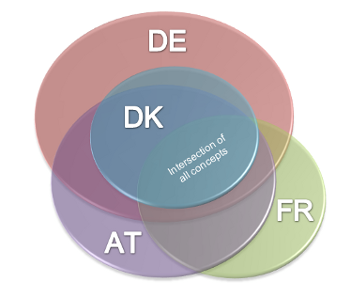
SEMIC.EU Core Person’s business need
Goal of the SEMIC.EU Core Person
Development of a global schema on natural person to identify a natural person unequivocally.
Development of an interoperability asset which enables cross-border data exchange (AT, DE, DK, FR, ...)
Find a minimum set of common ground

Slide 25
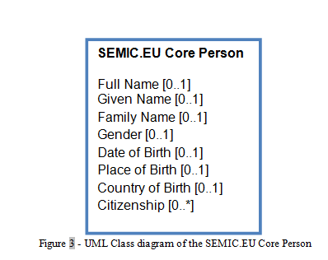
Pilot of shared development
Define the use case
Specify the data which has to be represented in the schema.
Reuse existing material
Search for assets in the repository that could be reused or adopted.
Reduce Complexity
Concentrate on data which really is required. Minimize the number of attributes. Keep schema as simple as possible.
Semantic Documentation
An exact semantic documentation is indispensible to guarantee the proper reuse of a schema.

Slide 26
Implementation details
Key requirements:
KISS Principle (Keep it simple and stupid)
Mapping
Loss of information has to be accepted or avoided by adding business specific information
Extensibility
The exchange format has to be easily extensible for other use cases.

Slide 27
SEMIC.EU Core Concept
.DK
.SE
Member State A
SEMIC.EU
European Exchange
Format
Information &
data model
.NL
Identifying
characteristics
SEMIC.EU
Core Concept
.ES
.FR
.BE

