Slide 1
XBRL Europe week
Madrid, 1st June 2012
“ Practical use of Dimensiones, Formulae and Data Point Modelling in Integrated Reporting Taxonomy (IS-FESG)”
Speaker: María Mora (maria.mora@atos.net)

Slide 2
The evolution: Business Reporting VS XBRL standard
Integrated Reporting
  Why the need of Integrated Reporting?
  What is the main goal?
The taxonomy : Integrated Scoreboard of Financial, Environmental Social and Governance indicators (IS-FESG)
  Dimensions + Data Point Modeling
  Formulae
  Financial relationship: IFRS, USGAAP, IPP and PGC2007
  Risk relationship: COREP
  Data identification relationship: Data of General Identifications Taxonomy (DGI)

Slide 3
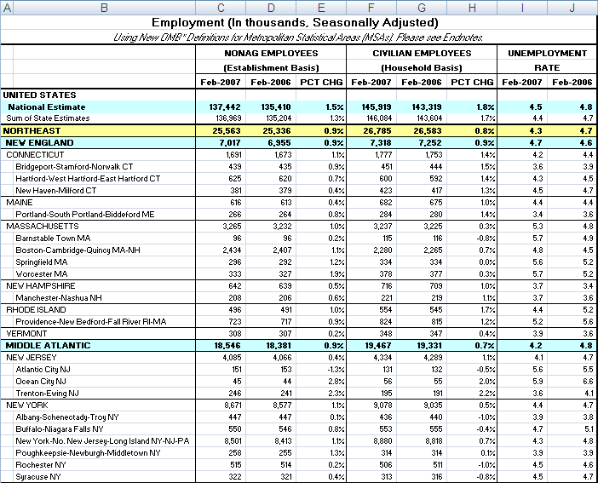
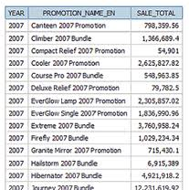
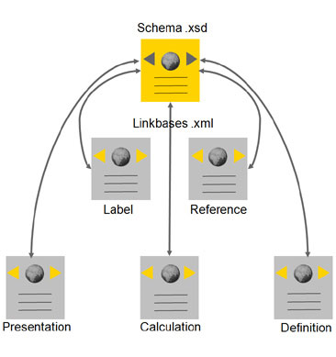

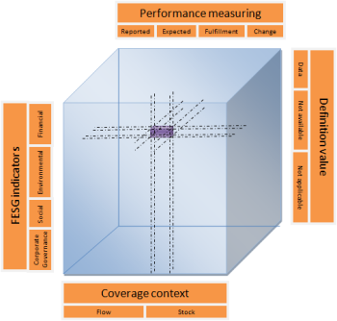

The evolution: Business reporting VS XBRL standard
2003
2005
2009
2011
XBRL 2.1
Dimensions 1.0 Specification
Formula 1.0 Specification
DPM
Notes:
2

Slide 4

Why the need of Integrated Reporting? – Actual state
The economic uncertainty and the lack of confidence, makes pay more attention to the investment strategies and quick decision making.
The business information is an element of competitive advantage.
The large volume of data, disjointed, irrelevant, with a little strategic significance, does not convey the real state of a company.
  Connecting financial, social, environmental and government information.
  Containing quantitative and qualitative information truly relevant about
  strategy .
  Creating value for the shareholders and stakeholders
  Promoting the exercise of Corporate transparency
What is the main goal ?
Connect financial and nonfinancial information in a unique block

Slide 5





The taxonomy for Integrated Reporting - (IS – FESG Taxonomy)
In a format
  Clear
  Concise
  Consistent
  Comparable
Brings together
  Financial
  Environmental
  Social
  Corporate Governance
IS-FESG
Taxonomy
Notes:
4

Slide 6
KPI indicators

Slide 7

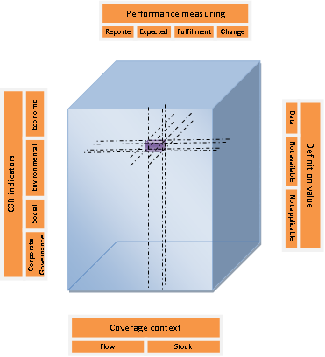
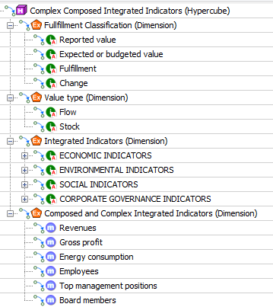
Representation of the Business reality
DATA POINT MODEL + DIMENSIONS
Quantitative
Flow
KPI
Stock
Qualitative
Financial
Entity
Social
Environment
Environmental
Governmental
Engagement
Historical
Prospective
Notes:
6

Slide 8




New levels of complexity (Basic, composed and complex indicators)
F1
/(S2+E2)
Complex Indicators
S1/S2
E1/E2
Composed Indicators
Financial
Social
Environmental
Governmental
Profit
People
Planet
Pilots
Basic Indicators
F1
S1
S2
E1
G1
FORMULAE
Assertion type rule validation
Notes:
7

Slide 9
Examples - different levels of KPI complexity
Basic
Revenues
Financial Indicators
Economic efficiency
KPI_F1 | Revenues
KPI_F2 | Suppliers expenses
KPI_F3 | Added Value
KPI_F4 | Employee compensation
KPI_F5 | Gross Profit
KPI_F6 | Financial expenses
KPI_F7 | Owners retribution
KPI_F8 | Public Administration expenses
KPI_F9 | Economic contribution to the community
KPI_F10 | R&D&I investment
KPI_F11 | Profitability
KPI_F12 | Level of debt
KPI_F13 | Treasury shares
Environmental indicators
Energy efficiency
KPI_E1 | Energy consumption
Composed
Employee Compensation
Revenues
XPATH Expression:
abs($composedEmployeeBenefits - ($basicEmployeeBenefits div $basicRevenue)) le threshold
Notes:
8

Slide 10
Example - different levels of KPI complexity
Financial Indicators
Economic efficiency
KPI_F1 | Revenues
KPI_F2 | Suppliers expenses
KPI_F3 | Added Value
KPI_F4 | Employee compensation
KPI_F5 | Gross Profit
KPI_F6 | Financial expenses
KPI_F7 | Owners retribution
KPI_F8 | Public Administration expenses
KPI_F9 | Economic contribution to the community
KPI_F10 | R&D&I investment
KPI_F11 | Profitability
KPI_F12 | Level of debt
KPI_F13 | Treasury shares
Environmental indicators
Energy efficiency
KPI_E1 | Energy consumption
KPI_E2 | Water consumption
KPI_E3 | Polluting emissions
Waste reduction efficiency
KPI_E4 | Waste generation
KPI_E5 | Waste processed
Complex
Energy consumption
Revenues
XPATH Expression:
abs($composedEnergyConsumption - ($basicEnergyConsumption div $basicRevenue)) le threshold
Notes:
9

Slide 11
Total of 30 formulas

Slide 12
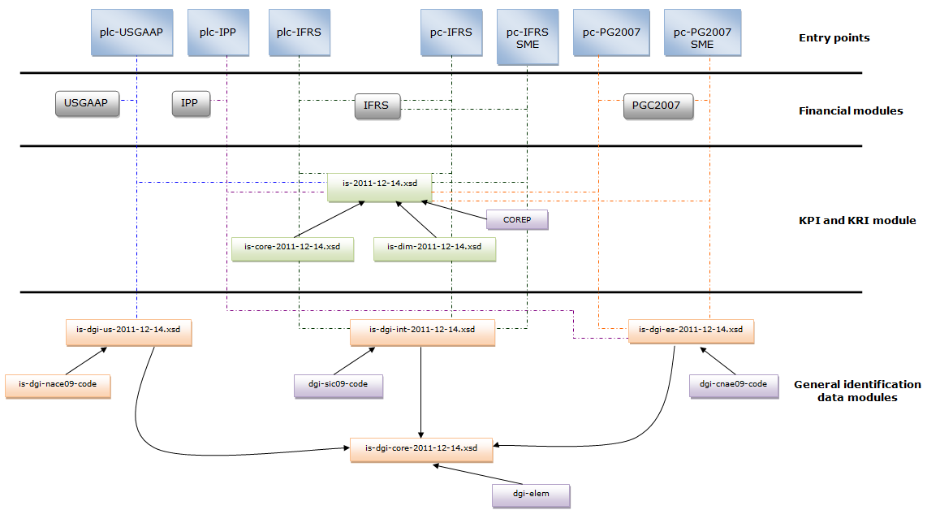
Architecture of the taxonomy - (European, American and Spanish)
Listed and non companies and SMEs
Notes:
11

Slide 13
XBRL shows new possibilities to discover
This proposed IS-FESG taxonomy architecture the promotes taxonomy extensions, for a double purpose:
  From the issuer´s perspective: extend the taxonomy, by adding new columns (dimensions) or validation rules (formulae),
    Increasing the complexity of the public reports,
    Adapting to the behaviors that the stakeholders and entity managers will be required to monitor .
  From the analyst´s perspective: use additional dimensional relationships and/or formulae to perform specific treatments on entity data, at the taxonomy layer, without the need for software re-programming.

Slide 14

XBRL Europe week
Madrid, 1st June 2012
Thanks for your attentions
Thank you for your attention
María Mora (maria.mora@atos.net)

