Slide 2
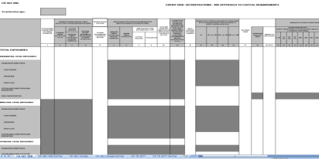
Reducing the burden of building taxonomies
COREP Network
A model understood by both domain and IT experts
Business users define and review the model
A set of rules defines how the model is represented as a XBRL taxonomy
Tools can be used to automate the production of taxonomy files
Matrix
schemas
DPM
(analysis temp)
Matrix
schemas
XBRL Network
Taxonomy

Slide 3
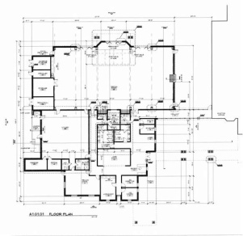
Computer aided design of financial models
Link between the model and taxonomy elements
DPM Architect for XBRL
Model design
Rules
Data Point Model
Taxonomy files
Notes:
The focus is in the design of the model. The tool should support domain experts during the process of designing the models. That model is formalized in taxonomy files
There’s no place for the XBRL expert in the design process

Slide 4
Characteristics of the DPM ARCHITECT

Slide 5
Common dictionary of data / A unique view of the model
Common
layer
Dictionary of concepts
Labels
References
Presentation hierarchies
Basic calc.
relationships
Framework specific layer
COREP 2013
FINREP 2013
Tables
Tables
Table context
labels
Required data sets
Graphical
disposition
Validation rules

Slide 6

SPEAKS XBRL
Every single piece of information in a taxonomy:
  Corresponds to a part of the model:
    Metric⬄ XBRL primary item
    Dimension ⬄ XBRL dimension
    Columns header ⬄ table axis
    Validation rule ⬄ assertion
  Obtained from the model using a bidirectional rule
    -The schema file for the members of a domain with code CP follows the rule:
    dict/dom/cp/cp.xsd
No hidden information! No hidden decisions!
No dependencies of a specific tool

Slide 7
Extensible
Common European concepts
ECB
EBA
EIOPA
Banco de España
Banque de France

Slide 8
Extensible
Common European concepts
ECB
EBA
EIOPA
Langs: en
Langs: en
Langs: en
Banco de España
Banque de France
Langs: en, es
Langs: en, fr

Slide 9
A replacement for commercial tools?

Slide 10
hypercubes??? What hypercubes???

Slide 11
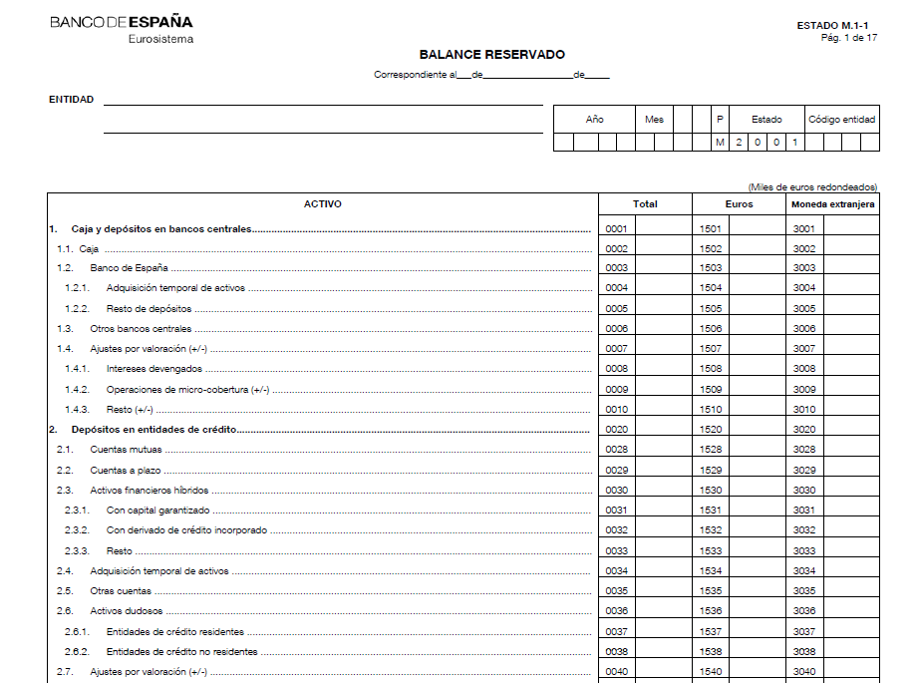
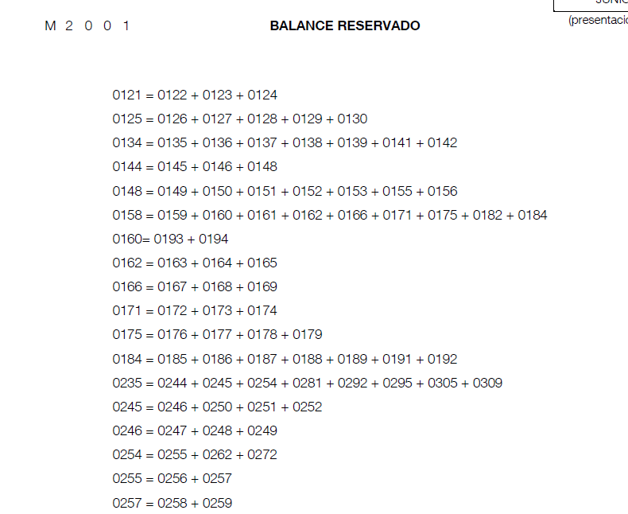
NEW EDITOR: Validation rules
Our current process of definition of rules is time consuming and error prone:
  Domain experts
  IT experts

Slide 12
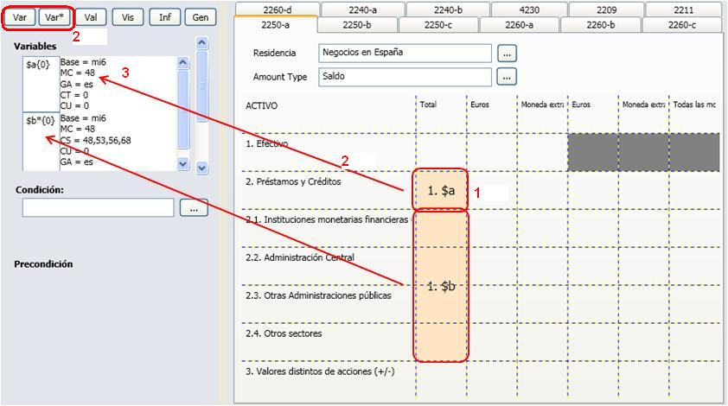
NEW EDITOR: Validation rules
Identification of input concepts of a validation rule:
  Model
  Assisted by graphical representation of tables (drag & drop)

Slide 13
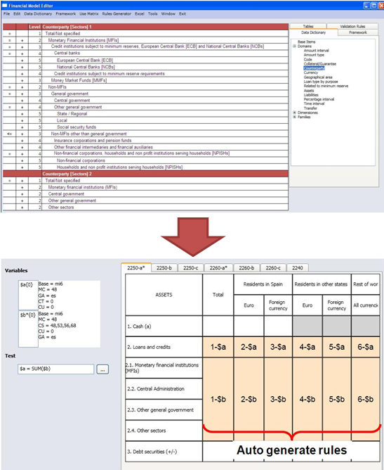
NEW EDITOR: Validation rules
Intelligent suggestions to extend rules
Automatic generation of rules from basic concept relationships
Arithmetic operations automatically include tolerance for rounding errors
  Users can provide exceptions for special cases
Error messages automatically generated

Slide 14



NEW EDITOR: documentation
Description of rules generated automatically:
  BdE cell coding notation
  COREP network’s row / column notation
  Model notation
Automatic inclusion of error messages
Validation rules report:
  Document with validation rules of a taxonomy and its description
Tables & model link documentation
Changes report

Slide 15
NEW editor: other features
Source code and technical documentation in English
Strictly following XBRL standards
Big effort put in the quality of the code

