Slide 1
FINREP and COREP v2.0: Filing perspective - Validations
19 June 2013 | London
Owen Jones | CRR Taxonomy Project EBA

Slide 2
Afternoon
How exactly do validations work?
More techy bits (Arelle etc validations, issues)
Issues
Kinds of validations
Database structures
XBRL mapping
Possible future?
Demo?
Likely file sizes
Performance? Tools?

Slide 3
Purpose of Validations
XBRL validation formula:
Enable a step change in reporting quality
Allow filer to check data before submission
Communicate the rules unambigously

Slide 4
Validations

Slide 5
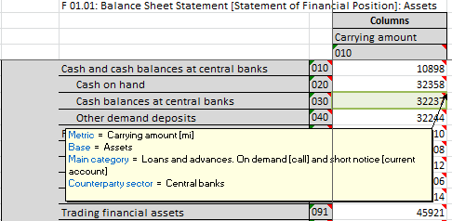
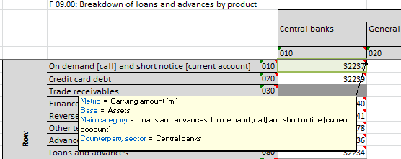
Identities
e.g. {F 01.01 , r030, c010} ≡ {F 09.00 , r010, c010}
These are intrinsic, fill in one cell and the other must take the same value automatically. The value is only reported once.
The cells refer to exactly the same piece of information.

Slide 6
Sign
e.g. {F 01.01 , r030, c010} ≡ {F 09.00 , r010, c010}
These are intrinsic, fill in one cell and the other must take the same value automatically. The value is only reported once.
The cells refer to exactly the same piece of information.

Slide 7
Hierarchies
Rules are produced automatically from the hierarchies of members specified in the DPM for domains of values.
e.g.
One of the hierarchies for the “Approach” domain states that
“Standardised approaches for commodities risk”
= ( “Maturity ladder approach”
+ “Extended maturity ladder approach”
+ “Simplified approach” )
Looking for places in the tables this might apply leads to the rule:
C 23.00 - Columns (010-060): {r010} = {r080}+{r070}+{r090}

Slide 8
Hierarchies
e.g. C 23.00 - Columns (010-060): {r010} = {r080}+{r070}+{r090}
Xpath expression $a = $b + $c + $d

Slide 9
Open Issues - Hierarchies
Validation rules at the moment are table centric
Places in tables where hierarchies could apply are found.
Rules are created to match just that place.
In XBRL
Could express the hierarchy relationship in general form.
XBRL validators would identify anywhere in the data it apply.
This is conceptually cleaner
Potential issues with partial reporting and fall back values.
May lead to unintended evaluations
Very unforgiving of modelling errors.
There may be performance considerations either way

Slide 10
“Manual” rules
These are rules that have been written by hand by business experts, e.g. :
C 07.00.a : {r150,c215} = {r150,c200} * 2% ($a = $b * 0.02)
C 10.01 : {r020,c070} >= 65% ($a >= .65)
C 16.00.a : if {r010,c010} > 0 or {r010,c020} > 0 or {r010,c030} > 0 then {r010,c070} > 0 (if ($a>0 or $b>0 or $c>0) then ($d>0) else (true)
C 25.00 (r020) : {c080} = max(c040}, {c050}) + max({c060},{c070})
F 02.00 (c010) : {r520} = sum(r530-570)
{C 42.00, r070,c010} = {C 45.01, r150,c030} + sum({C 01.00, c010, (r800, r842, r930-950)})

Slide 11
“Manual” rules - syntax
Normal algebraic expressions, most Xpath functions allowed (max, abs, if …)
Cell/column/row/sheet references
{C 45.01, r150, c030, s001} and variations
Sum, Cross-sum
sum({C 01.00, c010, (r800, r842, r930-950)})
sum({C 06.00, c100,(rNNN)})
xsum({C 01.00, (c010-030, r020-040)})
Each formula can be applied to a set of rows, columns or sheets
The formulae are simply translated to real XPath for XBRL

Slide 12
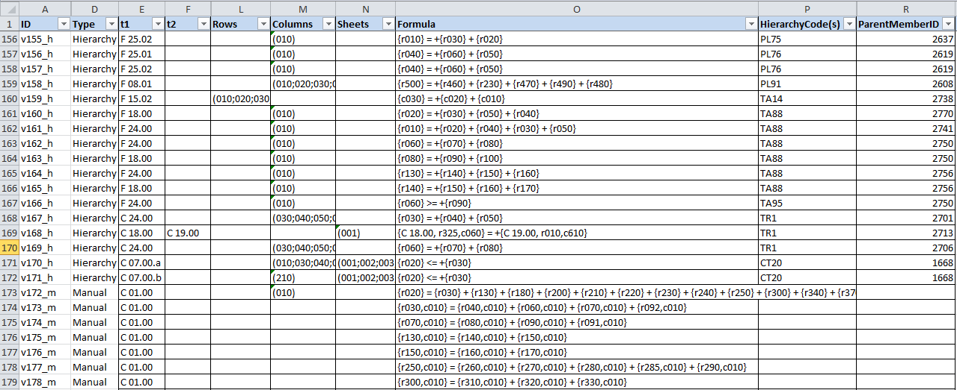
Representations – Rule Spreadsheet

Slide 13
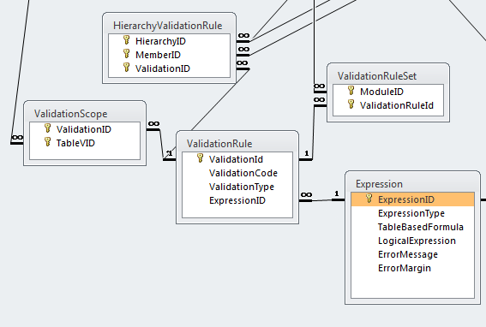
Representations – DPM Database

Slide 14
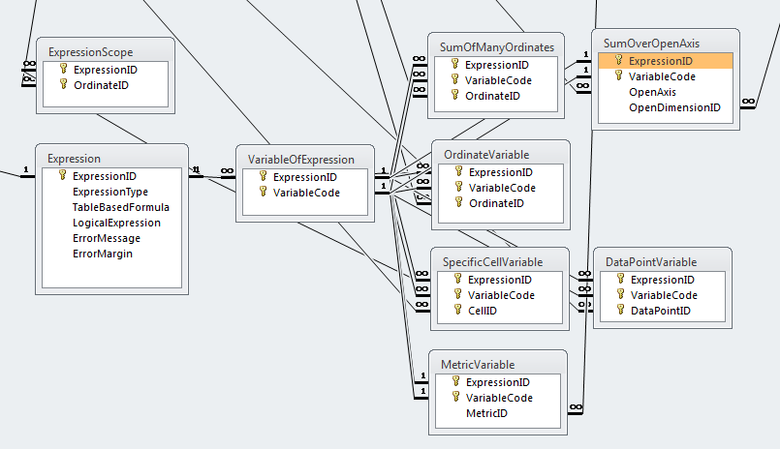
Representations – DPM Database

Slide 15
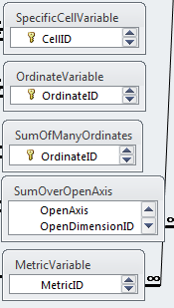
Representations – DPM Database - Variables
{C 45.01, r150, c030, s001}
{C 45.01, r150}
sum({F 15.02, (c010-030)}),
xsum({F 05.01.a, (r210, r260, c010-030)})
{C 10.01, r020} = sum({C 10.02, (rNNN)}),
sum({C 09.02, r130, c090, (sNNN)})
[Type of counterparty] IN {[Institutions],[Unregulated financial entities]}

Slide 16
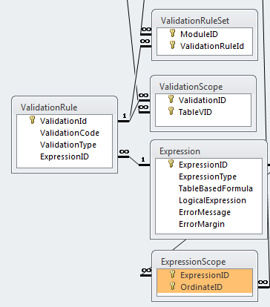
Representation - XBRL
Identifies with which modules the rules is associated (linked by).
Rules for common table sets are grouped into assertion sets.
Each rule has preconditions based on filing indicators for required tables.
“LogicalExpression” is the XPath expression used in XBRL
Rule has filters to restrict evaluations to these ordinates.

Slide 17
Representation – XBRL – Filing Indicators
Instance file contains XML Tuples indicating which tables are reported
<find:fIndicators>
<find:table contextRef="c1">C_26.00</find:table>
<find:table contextRef="c1">C_27.00</find:table>
…
</find:fIndicators>
[Creation of these with current XBRL software may be tricky…]

Slide 18
Representation – XBRL – Preconditions
Picked up by parameters (opportunity to override)
<variable:parameter xlink:type="resource" xlink:label="eba_tC_27_00" name="tC_27_00" select="find:fIndicators/find:table= 'C_27.00'" id="eba_tC_27_00" />
Used as preconditions for assertions
<variable:precondition xlink:type="resource" xlink:label="eba_pC_07_00_a" test="$tC_07_00_a" id="eba_pC_07_00_a" />

Slide 19
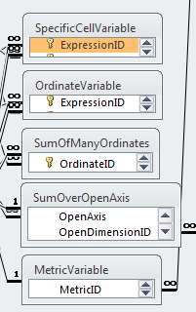
Representations – XBRL - Variables
$a – filter on sufficient to pinpoint a data point
$a – filter on sufficient to locate a column/row/sheet
sum($a) – bind as sequence, combine multiple ordinate dimensions with OR filter
sum($a) – bind as sequence, covers the open axis dimension
$a = ([CT:x6],[CT:x50]) / ("A","A*","B","D","N","U")

Slide 20
Example - Formula
v175_m: {C 01.00, r130,c010} = {C 01.00, r140,c010} + {C 01.00, r150,c010}

Slide 21
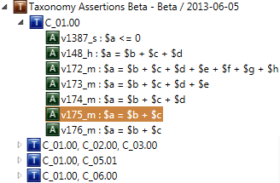
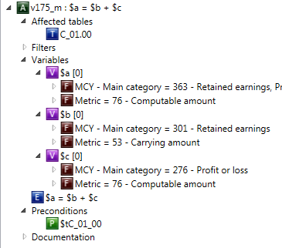
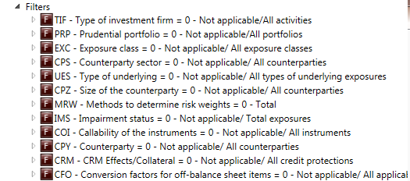
Example - XBRL
v175_m: {C 01.00, r130,c010} = {C 01.00, r140,c010} + {C 01.00, r150,c010}

Slide 22
“Manual” rules
Sufficient?
Have we got all the rules that are needed?
Necessary?
Have we included rules that might not always be true?
Lots of variety of types of institution / situation
Binary
XBRL has no standard mechanism for severity of error
How to include rules/warnings that probably apply (98% of the time)

Slide 23
Concerns/Challenges
1340 explicit validation rules
Potential for a lot of error messages!
Tools need to be designed to make it easy to identify source of errors
All the information is there in XBRL
Must be shown to users in a suitable form
Large Instances
Challenging performance requirements

Slide 24
Owen Jones

