Slide 1
EIOPA UPDATE XBRL Europe day
10 December 2013
Luxemburg

Slide 2
2013 Timeline
Publication of the updated version of DPM and Taxonomy for the Preparatory Phase
Publication of the Consultation version of DPM and Taxonomy for the Preparatory Phase
Nov-2013
Publication of the updated version of DPM and Taxonomy for the Preparatory Phase
PoC: MD for Open Tables
First internal draft full set SII templates
Mar-2013
EIOPA Reporting Seminar
Frankfurt
Jul-2013
Oct-2013
Dec-2013
2013
2013
Jan
Feb
Mar
Apr
May
Jun
Jul
Aug
Sep
Oct
Nov
Dec
2013
Mar-2013
Nov-2013
Publication of the SII Preparatory GL
CP-13/010
Publication of the Preparatory GL

Slide 3
Context of previous meeting
An uncertain world …
Uncertainty on Solvency II …
“Omnibus II” Trialogue discussions suspended, pending EIOPA report on long term guarantees
Leading to uncertainty on timing and content
EIOPA consultation on preparatory guideline running
Including a supporting DPM and taxonomy
EIOPA to make available a tool for undertakings to enable submission of information using XBRL in time for preparatory phase

Slide 4
Mid-year expectations
Post consultation update of DPM/Taxonomy (end of year)
A subset of the unique Solvency II taxonomy, not a different one (e.g. using entry points)
Tool for Undertakings: availability planned for end of 2013

Slide 5
Since then … (1)
EIOPA report on long term guarantees delivered (June)
Trialogue discussions resumed
Political agreement reached in November
Omnibus II proposal published
“Quick fix 2”: Entry in force of Solvency II: 1/1/2016

Slide 6
Incidence on reporting
Of timing
First regular report Q2 2016 (on Q1 2016)
Possible day-0 (1/1/2016) report
Lighter than an annual report
Ad-hoc. XBRL ?
Of Omnibus II dispositions
Currently being analyzed
Final outcome depends on
Formal adoption of Omnibus II (Parliament)
Availability of implementing measures proposals (COM)
Expected availability: around summer 2014

Slide 7
Since then … (2)
Guidelines published on the 1^{rst} of November, in 23 languages
Electronic format (for quantitative & qualitative)
Possibility to use LEI for identification (note: EIOPA is member of the ROC)
One preparatory quarterly report (Q3 2015)
Submission (individual) : 25 November 2015 (+8 weeks)
Submission (group): 6 January 2016 (+14 weeks)
One preparatory annual report (Year 2014)
Submission (individual): 3 June 2015 (+22 weeks)
Submission (group): 15 July 2015 (+28 weeks)
Draft translated Annex II files available to supervisors
Public availability, post quality checking
Comply or explains process currently running

Slide 8
Incidence on reporting
Supporting DPM and taxonomy published
Subset of the final one
Some feedback received
Short release cycle envisaged
Update of the preparatory material subset
Scope extension(s) up to the comprehensive one

Slide 9
Taxonomy November release
Nov-2013
Covering:
Latest business requirements updated mid-October covering: Solo, Group, Quarterly, Annual, Public Disclosure.
DPM update incorporating the latest changes approved by SG3 (up until 21/08/2013)
Subset of assertion formulas
Filing indicators updated to match the latest version
Use of 2013-05-17 (“Dublin”) PWD version of the Table Linkbase specification
HD and MD layer (coded prototype conversion included in the Nov.4 release)
Updated technical documentation
Preparatory SII DPM and XBRL Taxonomy

Slide 10
Taxonomy December release
Dec -2013
Covering:
Primary focus on Bug Fixing
Improve documentation
Provide Release Notes documentation
PoC: MD approach for Open Tables
NB. This will not contain any assertion formulas
Preparatory SII DPM and XBRL Taxonomy

Slide 11
PoC Taxonomy December release
Dec -2013
For Open tables, data points which were captured as dimensions in HD and facts in MD will now be consistently captured as dimensions.
This means there will be fewer facts for MD open tables but those facts will have more dimensions in their (shared) context.
Advantages
Simpler conversions
More understandable MD model
Elimination of bugs caused by inconsistencies in this area
Potentially smaller instance sizes
Preparatory SII PoC DPM and XBRL Taxonomy

Slide 12
2014 Taxonomy Timeline
May 2014:
Publication of the Final Preparatory SII DPM and XBRL Taxonomy
Publication of the Manual for Fillers
Publication of the Manual for NSAs
Confirmed
February 2014:
Candidate release of the Preparatory SII DPM and XBRL Taxonomy
Candidate release of the Target SII DPM and XBRL Taxonomy, following the EIOPA Business Timeline for SII Reporting requirements
April 2014: Candidate release of the Target SII DPM and XBRL Taxonomy, following the EIOPA Business Timeline for SII Reporting requirements
May 2014: Candidate release of the Target SII DPM and XBRL Taxonomy, following the EIOPA Business Timeline for SII Reporting requirements
September 2014: Publication of the Final Target SII DPM and XBRL Taxonomy – Assuming that the final SII Guidelines will be available by July 2014
To be confirmed – dependent on the EIOPA Business Timeline for SII
2014
Jan
Feb
Mar
Apr
May
Jun
Jul
Aug
Sep
Oct
Nov
Dec
2014

Slide 13
Reporting Tool for Undertakings.
Greater harmonisation and coherent application of rules for financial institutions & markets across the European Union.
Adoption of open and free Data Point Model methodology, used by EBA and ECB, in order to explicitly, precisely and unambiguously describe Solvency II supervisory information requirements.
DPM
Adoption of open, free and globally used eXtensible Business Reporting Language to facilitate electronic transmission of data according to DPM model and governed by advanced XBRL data quality mechanism.
Provision of the Tool for Undertakings to mitigate the risk of undertakings not being able to communicate information to supervisors and in order to mitigate the risk of NCAs not being able to communicate information with other NCAs or EIOPA in a timely and required manner.
T4U

Slide 14
The Tool for Undertakings Project (TfU)
The Goals
Distribution license for all Europe. Preferable EUPL license
Internationalization: Languages, data formats, currencies, etc.
Using the input forms in a similar layout as the public reference templates.
Easy to use for administrative staff with limited IT knowledge
Allowing reusing or extension of the tool for national extensions
Easy to deploy
Use of XBRL label, rendering, reference, formulas, etc.
XBRL syntax and formula validation at client side
2nd level support
Easy to update when the taxonomy changes
Open source,
reusable
Good performance with large amounts of data
Multiplatform
Note that these requirements are under discussion and not final

Slide 15
Since then … (3)
EIOPA’s Board of Supervisors in September postponed the decision on implementation of the Tool for Undertakings.
Two possible ways forward currently analyzed in more depth:
Option 1: server and licenced based solution
Option 2: bespoke standalone solution
Decision to be taken end of January by EIOPA’s Board of Supervisor

Slide 16
Standalone solution Functions: In and Out of Scope
✓
✓
✗
Easy-to-use with multiple Data Input Interfaces
Generation of XBRL Reports according to Solvency II DPM XBRL Taxonomy (Level 1 & 2)
Reports and submissions management
✓
✓
✗
XBRL Validation (open source component) for Reported Data
XBRL load, validation and creation with database approach
Support for other XBRL Architectures than EIOPA / Eurofiling
✓
✓
✗
DPM Database for Metadata and Data
Generation of XBRL Taxonomy according to Eurofiling Architecture
Adavanced data analysis
✓
✓
✗
Basic BI analysis capabilities
Second-level support
First-level support
/ support services for extensions

Slide 17
Standalone solution architecture
DPM
annotated templates
XBRL taxonomy
NCAs
Undertakings
DPM Architect
MS Excel templates / Windows
Forms
Group parent
XBRL report
NCAs
DPM Database (metadata and data)
Data quality / Arelle XBRL validation service
Other formats
EIOPA
XBRL report
Reporting
Data quality check
Data and metadata
XBRL generation

Slide 18
Standalone solution timeline
Scope of requirements definition
11/01/13 - 03/01/14
121 Days
Prototype
12/01/13 - 01/15/14
46 Days
Development
12/02/13 - 05/20/14
170 Days
Stabilize
05/20/14 - 06/20/14
32 Days
Launch
06/17/14 - 06/27/14
11 Days
BoS Decission Go No-go Decision
01/30/14
First Public Beta
Release candidate
Today
01/03/14
01/05/14
2013
Nov
Dec
Jan 2014
Feb
Mar
Apr
May
Jun
2014
01/12/13
15/01/14
30/06/14
Project Kickoff
Alpha Internal Release
Project Development Close

Slide 19
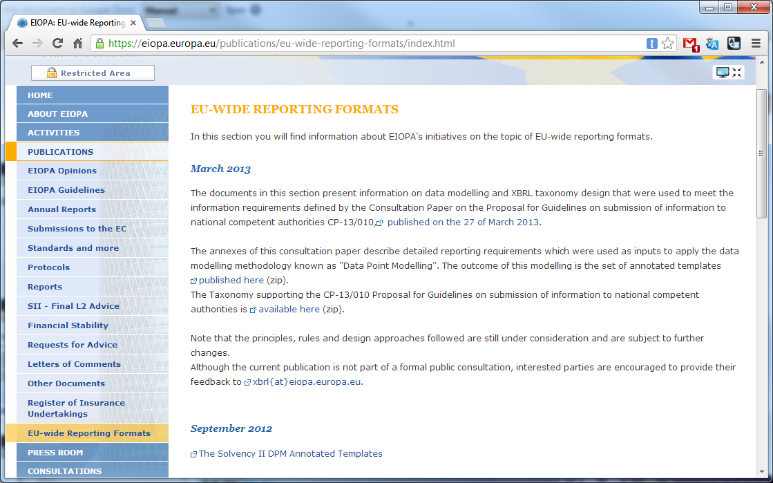
Keeping up to date
https://eiopa.europa.eu/publications/eu-wide-reporting-formats/index.html

Slide 20
Thank you
Pierre-Jean Vouette
Pierre-Jean.Vouette@eiopa.europa.eu

