Slide 1
IFRS Taxonomy 2014
Wladek Krawiec
IT Project Manager – IFRS Taxonomy

Slide 2
Agenda
The IFRS Taxonomy
Scope and development of the IFRS Taxonomy
Details of main changes since the IFRS Taxonomy 2013
Statistics
Supporting materials
Upcoming IFRS taxonomy interim releases
Notes:
Olivier

Slide 3
The IFRS Taxonomy
Notes:
Olivier

Slide 4
The IFRS Taxonomy
The IFRS Taxonomy is consistent with XBRL technical specifications and is designed to properly reflect the International Financial Reporting Standards (IFRSs) as issued by the IASB.
The 2014 annual version of the IFRS Taxonomy was released on 5 March 2014 and reflects the IFRSs as at 1st January 2014, including Standards published but not yet effective at that date.
Over 120 countries have already adopted IFRS and many of them are now implementing XBRL and the IFRS Taxonomy.
© 2014 IFRS Foundation. 30 Cannon Street | London EC4M 6XH | UK. www.ifrs.org
Notes:
Olivier

Slide 5
The IFRS Taxonomy: scope and development process
Notes:
Olivier

Slide 6
What do we consider when creating tags?
IFRS authoritative documents (IFRS Bound Volume)
  Part A: Standards (IASs, IFRSs, SICs, IFRICs) and their application guidance; and
  Part B: accompanying documents (illustrative examples, guidance on implementing, basis for conclusions).
IFRS financial reporting in practice:
  Companies’ financial statements, by way of empirical analysis, interaction with all stakeholders (issuers, regulators, users of financial statements);
  Illustrative financial statements of the Big 4 firms; and
  Any other type of relevant information.
© 2014 IFRS Foundation. 30 Cannon Street | London EC4M 6XH | UK. www.ifrs.org
Notes:
Olivier

Slide 7
Decision tree
Disclosure
IN SCOPE
Y
Example
Is the element coming from the IFRS Bound Volume?
Y
NOT IN SCOPE
Y
Does the element infringe IFRS reporting requirements?
Does the element impact an IFRS financial report?
Y
N
Is the element commonly reported in IFRS financial reports?
N
Common & Industry practice
N
NOT IN SCOPE
NOT IN SCOPE
N
Notes:
Olivier

Slide 8
Development timeline – 2014 Taxonomy
End of annual taxonomy development cycle
Proposed
Interim Release 2
development
XQRT review
Proposed Interim Release 2
Compilation of Final IFRS Taxonomy
New / improved IFRSs
IFRS Taxonomy interim releases
NOV 2013
DEC 2013
JAN 2014
FEB 2014
MAR 2014
APR 2014
LATER
15 January: Proposed Interim Release 2
14 February: End of consultation
Early March: Annual IFRS Taxonomy 2014
Notes:
Olivier

Slide 9
Main changes since the
IFRS Taxonomy 2013

Slide 10
Content

Slide 11
IFRS Taxonomy – Hedge Accounting
In November 2013 the IASB published IFRS 9 Financial Instruments (Hedge Accounting and amendments to IFRS 9, IFRS 7 and IAS 39)
Main changes resulting from the publication:
  133 new elements added for Hedge Accounting mainly within the financial instruments section ([822390] Notes – Financial instruments)
  181 references changed due to removal of mandatory effective date of IFRS 9
© 2014 IFRS Foundation. 30 Cannon Street | London EC4M 6XH | UK. www.ifrs.org
Notes:
Bartek

Slide 12
IFRS Taxonomy – Hedge Accounting
Detailed changes resulting from Hedge Accounting
  New tables for disclosures relating to:
    Risk management strategy in relation to hedge accounting
    Terms and conditions of hedging instruments
    Detailed information about hedging instruments and hedged items
    Impact of hedge accounting on statement of comprehensive income
    Credit exposures designated at fair value through profit or loss
  Additional elements for IAS 1 Presentation of Financial Statements (statement of comprehensive income, statement of changes in equity)
  Changes to the existing table for analysis of other comprehensive income
© 2014 IFRS Foundation. 30 Cannon Street | London EC4M 6XH | UK. www.ifrs.org
Notes:
Bartek

Slide 13
IFRS Taxonomy – Common Practice
Since 2012 the IFRS Taxonomy includes elements that reflect common reporting practices within IFRS financial statements. The elements are added to the Taxonomy based on empirical analysis of a sample of real life IFRS financial statements.
In 2013, the analysis comprised telecommunication and real estate activities.
In addition to activity specific elements, a number of general elements were identified during the analysis. After verification, these elements were also added to the IFRS Taxonomy.
© 2014 IFRS Foundation. 30 Cannon Street | London EC4M 6XH | UK. www.ifrs.org
Notes:
Bartek

Slide 14
IFRS Taxonomy – Common Practice
Detailed changes resulting from common practice analysis:
  14 new elements relating to telecommunication activity – 10 line items and 4 members
  29 new elements relating to real estate activity – 26 line items, 1 axis, 2 members
  39 new elements relating to general reporting – 28 line items, 2 axes, 9 members
  12 elements deprecated (as a result of introduction of an additional axis)
© 2014 IFRS Foundation. 30 Cannon Street | London EC4M 6XH | UK. www.ifrs.org
Notes:
Bartek

Slide 15
IFRS Taxonomy – Amendments to IAS 36
In May 2013 the IASB published Recoverable Amount Disclosures for Non-Financial Assets (Amendments to IAS 36)
Main changes resulting from the publication:
  5 new elements added (section [832410] Notes – Impairment of assets)
  5 elements updated (section [832410] Notes – Impairment of assets)
© 2014 IFRS Foundation. 30 Cannon Street | London EC4M 6XH | UK. www.ifrs.org
Notes:
Bartek

Slide 16
IFRS Taxonomy – Annual Improvements to IFRSs
In December 2013 the IASB published Annual Improvements to IFRSs (2010-2012 cycle).
Main changes:
  1 new line item added for IFRS 8 Operating Segments disclosures
  1 new table (3 elements) added for IAS 24 Related Party Disclosures
  3 existing line items linked to sections relating to IAS 16 Property, Plant and Equipment and IAS 38 Intangible Assets
© 2014 IFRS Foundation. 30 Cannon Street | London EC4M 6XH | UK. www.ifrs.org
Notes:
Bartek

Slide 17
Architecture

Slide 18
IFRS Taxonomy Architecture
The Proposed Interim Release 1 (September 2013) introduced changes to the architecture of the IFRS Taxonomy.
As a result of the negative feedback received, the Proposed Interim Release 2 (January 2014) included a document describing an amended proposed change to the architecture of the Taxonomy.
The document was well received and the change has been implemented in the annual IFRS Taxonomy 2014.
© 2014 IFRS Foundation. 30 Cannon Street | London EC4M 6XH | UK. www.ifrs.org
Notes:
Andie

Slide 19
IFRS Taxonomy Architecture
Main features of the final architecture:
  Separate namespaces for full IFRS, IFRS for SMEs and Management Commentary
  Use of ’import’ function only (instead of ’include’ function)
  Improved folder and file structure
Impact:
  More elements (IFRS for SMEs elements independent of full IFRS)
  No software issues
  Improved navigation
© 2014 IFRS Foundation. 30 Cannon Street | London EC4M 6XH | UK. www.ifrs.org
Notes:
Andie

Slide 20
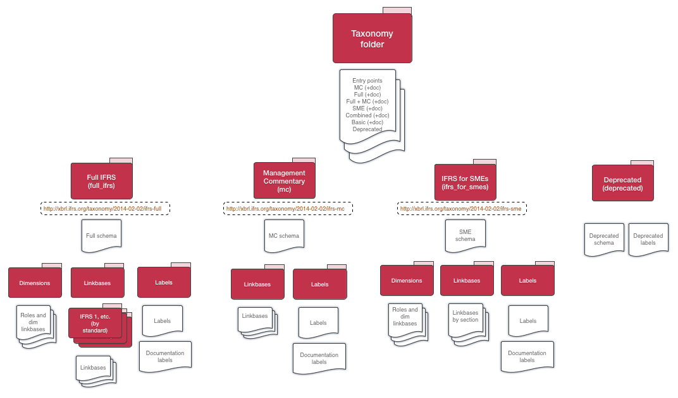
IFRS Taxonomy Architecture - planned
© 2014 IFRS Foundation. 30 Cannon Street | London EC4M 6XH | UK. www.ifrs.org
Notes:
Andie

Slide 21
Statistics

Slide 22
Statistics
Please note that the total number of elements increased significantly as a result of separation of full IFRS elements from IFRS for SMEs elements (until 2013 the same elements were used)
Number of taxonomy items | Final 2014 taxonomy | Final 2013 taxonomy | Final 2012 taxonomy | Final 2011 taxonomy
Total | 5,044 | 3,805 | 3,769 | 2,545
Full IFRS with Management Commentary, including: | 3,902 | 3,643 | 3,659 | 2,426
Disclosure requirements (part A of the Bound Volume) | 2,172 | 2,047 | 2,153 | 1,727
Examples (part B of the Bound Volume) | 417 | 415 | 408 | 290
Common Practice | 862 | 772 | 692 | 117
IFRS for SMEs | 1,142 | 1,142 | 1,138 | 1,128
© 2014 IFRS Foundation. 30 Cannon Street | London EC4M 6XH | UK. www.ifrs.org
Notes:
Bartek

Slide 23
Supporting materials

Slide 24
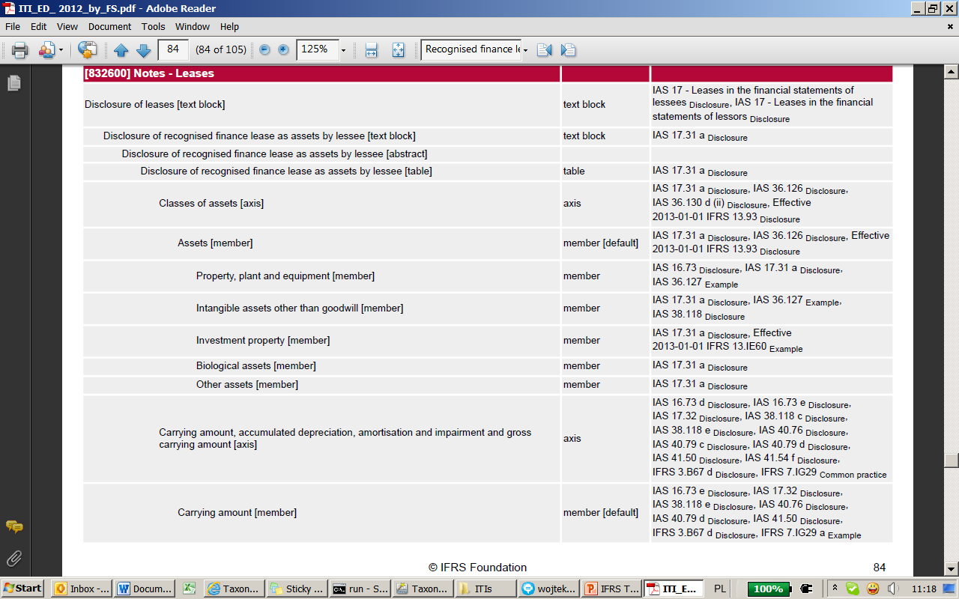
IFRS Taxonomy Illustrated (ITI)
© 2014 IFRS Foundation. 30 Cannon Street | London EC4M 6XH | UK. www.ifrs.org
Notes:
Bartek

Slide 25
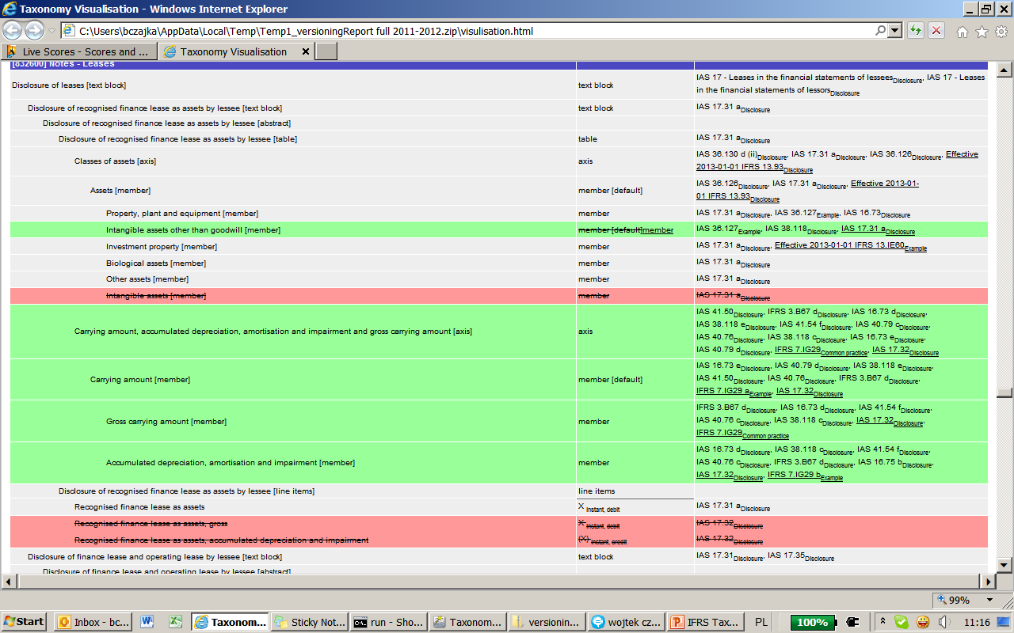
Versioned IFRS Taxonomy Illustrated
© 2014 IFRS Foundation. 30 Cannon Street | London EC4M 6XH | UK. www.ifrs.org
Notes:
Bartek

Slide 26
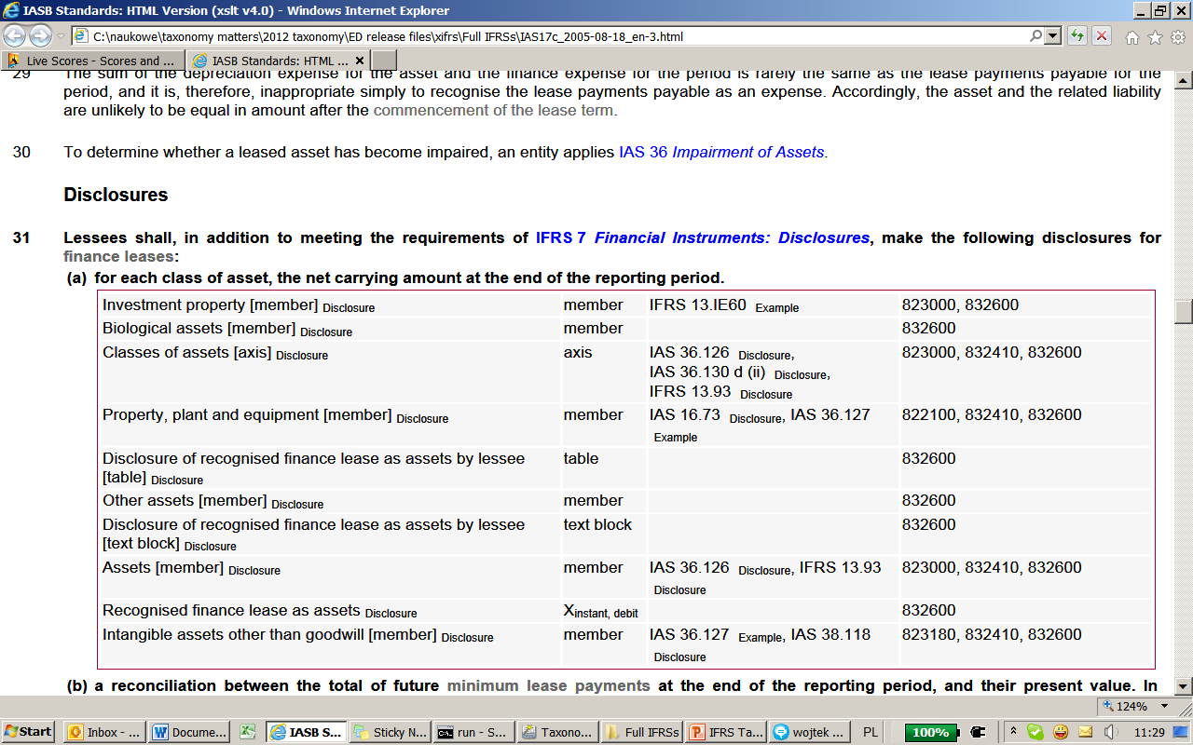
xIFRS
© 2014 IFRS Foundation. 30 Cannon Street | London EC4M 6XH | UK. www.ifrs.org
Notes:
Bartek

Slide 27
IFRS Taxonomy 2014 files

Slide 28
IFRS Taxonomy 2014 files
All files available at: http://go.ifrs.org/IFRST2014
IFRS Taxonomy files, including entry points
IFRS Taxonomy Illustrated:
  PDF format:
  HTML format, with taxonomy versioning information:
xIFRS (IFRSs with XBRL)
Excel file providing taxonomy view with documentation labels
Illustrative Examples
IFRS Taxonomy Guide 2014
© 2014 IFRS Foundation. 30 Cannon Street | London EC4M 6XH | UK. www.ifrs.org
Notes:
Bartek

Slide 29
Future IFRS Taxonomy Interim Releases

Slide 30
IFRSs impacting IFRS Taxonomy in 2014
IASB Final Standards
Topic | IASB due process stage | Date planned | Impact
Rate-regulated activities | IFRS published |  | significant
Revenue recognition | Target IFRS | Q2 2014 | significant
Classification and measurement (IFRS 7 & IFRS 9) | Target IFRS | H1 2014 | limited to significant
Impairment | Target IFRS | H1 2014 | significant
Notes:
Bartek

Slide 31
IFRSs impacting IFRS Taxonomy in 2014
IASB Final Standards (if final IFRS in 2014)
Topic | IASB due process stage | Timing | Impact
IFRS for SMEs review | ED comment period | ended 3 March 2014 | significant
Annual Improvements 2012–2014 | ED comment period | ended 13 March 2014 | limited
Leases | Redeliberations |  | significant
Insurance contracts | Redeliberations |  | significant
Macro hedge accounting | Discussion Paper | Published Q2 | significant
Notes:
Bartek

Slide 32
Common and industry practice in 2014
Topic | Industries | Timing | Impact
Common and industry practice | pharmaceuticals, retail, transport and possibly others | Q2/Q3 2014 | Significant
Notes:
Bartek

Slide 33
Contact us
You can direct your enquires to:
Bartek Czajka (accounting content questions) bczajka@ifrs.org
Wladek Krawiec (technical questions)
wkrawiec@ifrs.org

Slide 34

Questions or comments?
Expressions of individual views
by members of the IASB and
its staff are encouraged. The views expressed in this presentation
are those of the presenter.
Official positions of the IASB on accounting matters are determined only after extensive due process and deliberation.
© 2014 IFRS Foundation. 30 Cannon Street | London EC4M 6XH | UK. www.ifrs.org
Notes:
34

Slide 35

Thank you

