Slide 1
Updates to Table Linkbase Model-based Overview
16th Eurofiling Workshop
12 December 2012
Herm Fischer
Rendering Working Group
(Models by Jon Siddle, CoreFiling)

Slide 2
What is Table Linkbase?
Abstract model for viewing (~presentation)
Implementation of tables and form
Replaces presentation linkbase
Yes – for case of specifying rendering (e.g., SEC viewer)
No – for case of concept-to-concept hierarchy definition
Two 2 ½ versions circulating
Eurofiling (2010)
Montreal PWDs (2011)
(½) Oxford model-based updates (Nov. 2012)

Slide 3
Table Models (Oxford)

Slide 4
Table Models
Definition model
Models content of the linkbase
Independent of syntax
Independent of instance and its DTS
Structural model
Represents structure of the table
Captures meaning of business information table
Independent of definition
Rendering model
Structure and values for final output
All values and breakdowns projected onto X/Y/Z axes

Slide 5
Processes
Resolution
Transform definition model into structural model
May require instance and its DTS
Rendering
Transform structural model to rendering model
Project breakdowns onto X, Y, or Z axis
Create table headers (often from DTS labels)
Populate cell values (usually from instance)

Slide 6
Other participants
Input linkbase
Syntax describing table definition model
DTS
Taxonomies, linkbases to resolve definition into structure
Instance
Source of facts, to populate rendering model

Slide 7
Structural model
Each axis is a series of trees
Tree defines logical breakdown of facts
Nodes specify constraints of aspects for cells
Closed node constrains single column/row
Open node expands during rendering to multiple columns/rows

Slide 8
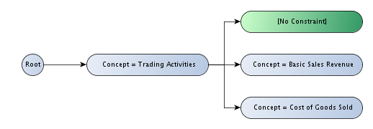
Breakdown trees

Slide 9
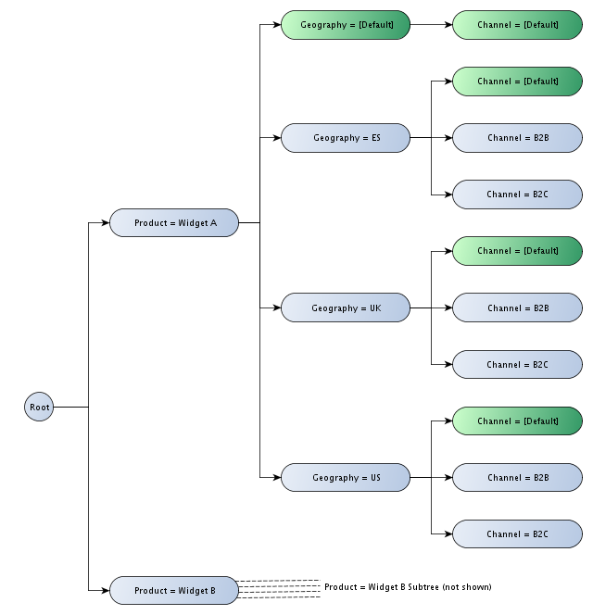
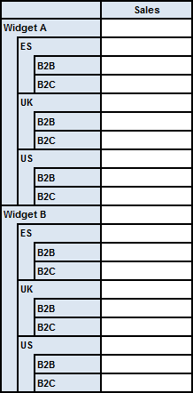
Two dims
Y axis

Slide 10
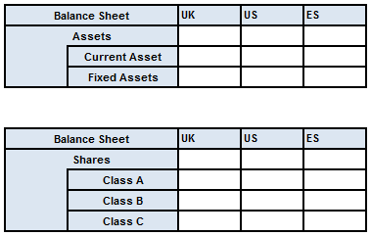
Table set
A sequence of tables with a common definition
Example, financial schedules of 2 link roles, balance sheets of assets and shares
Each table has different y axes despite having common definition

Slide 11
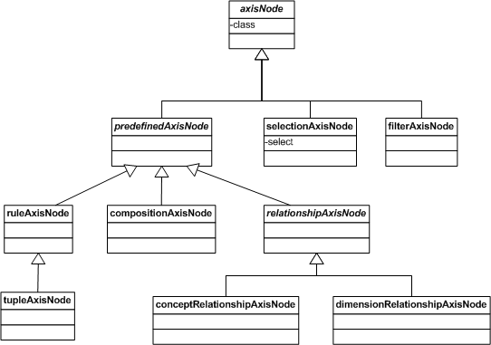
Definition axis-node model

Slide 12
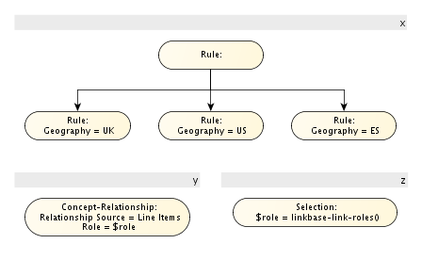
Table set definition model

Slide 13
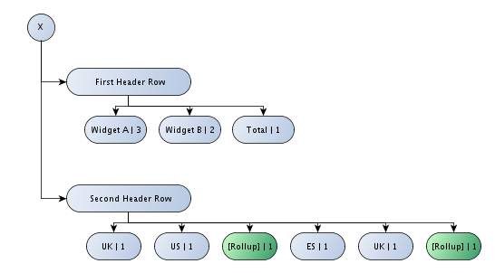
Rendering model, X-axis

Slide 14
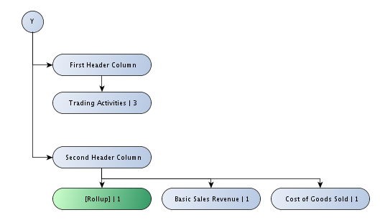
Rendering model, Y-axis

Slide 15
Resolving X-axis

Slide 16
Resolving Y-axis

Slide 17
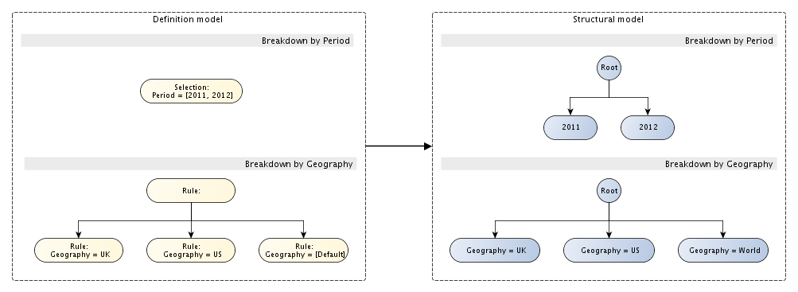
Resolving double X breakdown

Slide 18
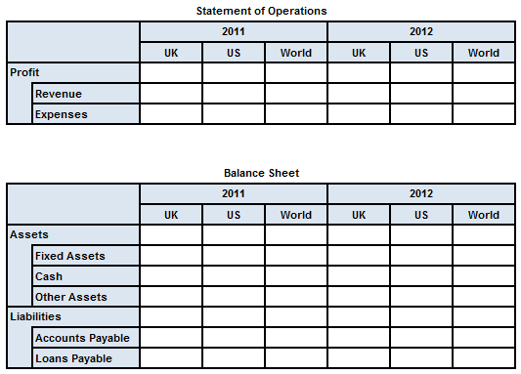
Resolving table set Z-axis

Slide 19
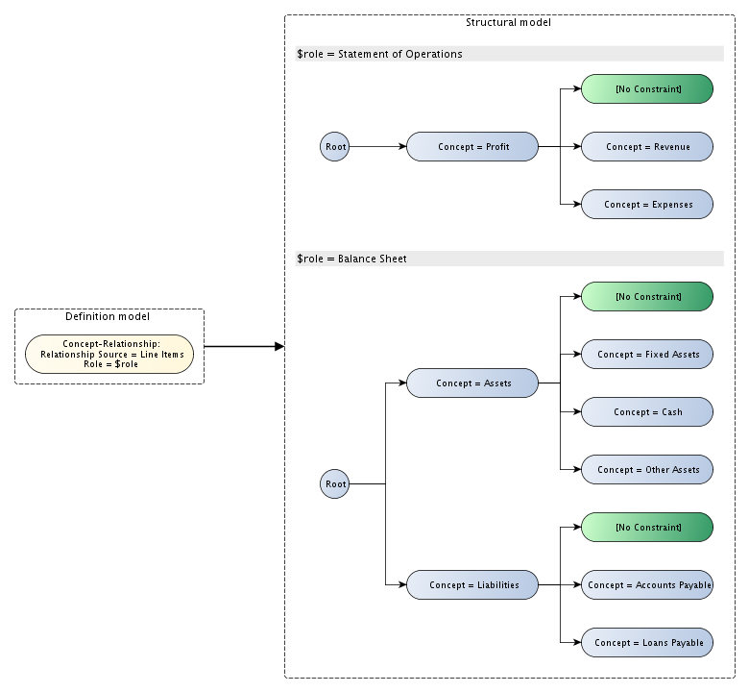
Resolving table set Y-axes

