Slide 1


CEN/WS XBRL
CWA1:
European Filing Rules
Data Point Meta Model
Data Point Methodology Guidance
European Taxonomy Architecture
18 June, 2013
Katrin Heinze, Bundesbank
CWA1

Slide 2
Objectives
Standardisation of the
  European XBRL architecture and common instance filing rules to
    cover appropriately the list of harmonisation topics listed in Annex B of the CEN WS XBRL Business Plan
    Facilitate transparency on the harmonised reporting data across Europe
    increase interoperability between services and applications
    overcome lack of harmonisation in the use of the XBRL standards
    reduce the reporting burden of international acting reporting entities by providing the possiblity to standardize the reporting processes
Definition of an
  European Data Point Methodology to
    represent the requirements of European reporting frameworks in a data model
    link the business requirements with the technical transfer format
    describes the rules to be recognised in the process of modelling
CWA1

Slide 3



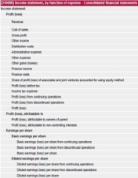


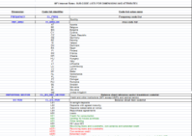

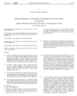



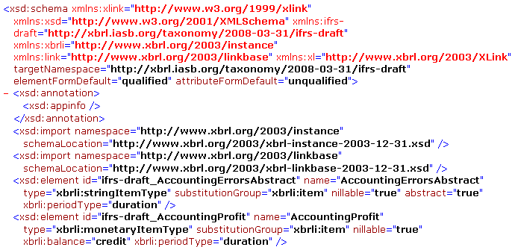
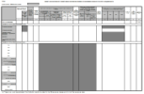

Level of Harmonisation in Europe
Reporting entity
XBRL Data Format &
XBRL Filing
Harmonised
Data Point Model
?
Not harmonised
Not harmonised
European
Reporting Frameworks
European Supervisor
© cundus AG
Notes:
First level reporting: reporting entities are banks and insurance companies, supervisors are NSAs
Second level reporting: reporting entities are national supervisors, European supervisorsa are EBA and EIOPA

Slide 4
Deliverables of CWA1
Official CEN Deliverables
  Specification document European XBRL Architecture
  Specification document European Filing Rules
  Non-normative document European Data Point Methodology
  Non-normative document DPM – Guidance document
  Non-normative document DPM -2-ROLAP (IWD)

Slide 5
European Filing Rules (EFR)
Rules (recommendations) to be followed for the preparation and validation of instance documents in an European filing process
Place additional constraints on XBRL instance document
Advantages
  Harmonization on a technical level
  Enhance the interoperability of IT systems
  Ease of comparison of reporting data
  Ease the validation of instance documents
  Giving rules to reporting entities as guidance
  Harmonized rules decrease the reporting burden for reporting entities across Europe
  Codified rules can be automatically tested
    currently only with proprietary software
XBRL Filing
?

Slide 6
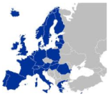

Related approaches
Approach | Year | Status | Publisher | Coverage | Rules on
FRIS¹ | 2004 | PWD² | XII³ | XBRL 2.1 - only | XBRL Instances
Global Filing Manual | 2010 | Best Practices | SEC, FSA Japan, IFRS | XBRL Standard | XBRL Instances and Taxonomies
European Filing Rules | 2013 | PWD² | CEN | XBRL Standard | XBRL Instances
European Filing Rules: part of the CWA1 deliverables of the standardization process of CEN/WS XBRL
oriented to reporting entities preparing the filings on basis of EIOPA and EBA taxonomies
Recommendations to be adopted by NSAs and other European Supervisory Authorities
FRIS
EFL
GFM
Financial Reporting Instance Standards
Public Working Draft
XBRL International Inc.

Slide 7
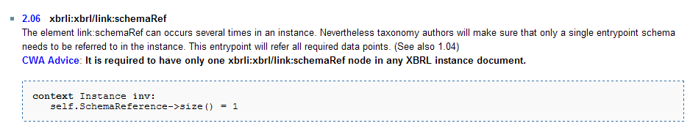
Structure of the Deliverable
Currently 48 rules and descriptions separated in two chapters
  10 Filing syntax rules
    Rules for the complete document to be filed
  38 Instance syntax rules
    Syntax rules for the instance document and its subordinated objects
      Contexts
      Facts
      Units
      Footnotes
Example:

Slide 8
Modeling the European Filing Rules
Filing rules are recommended to be implemented on sender and receiver side to ensure that the requirements of the filings are met
FRIS and GFM define rules in natural language exclusively
  → possible ambiguities while interpreting the rules
Rules must be easily understandable by software developers
Meta model provides model components, rules on how to combine components and the meaning (semantic) for the components and relations.
  UML class diagram to describe the structure of the XBRL instance by showing the classes, their attributes and possible methods.
  OCL (Object Constraint Language) is a formal language for specifications which refers to an UML model to describe constraints about the objects in the model.

Slide 9
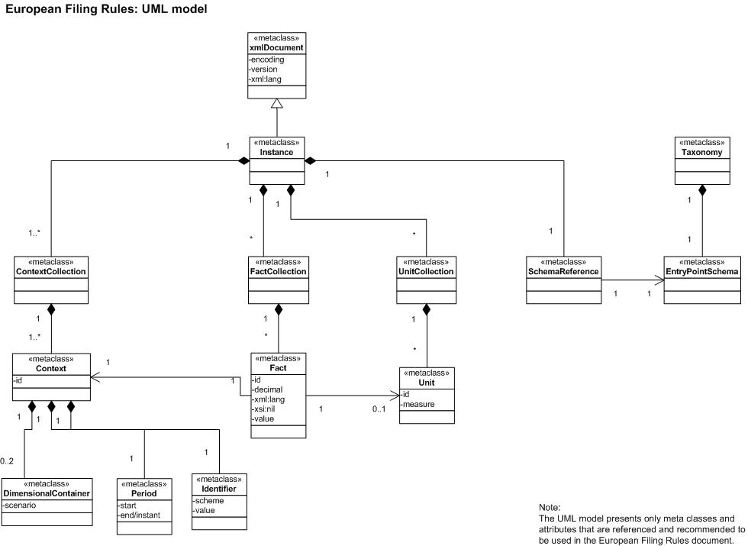
Draft model system for EFR

Slide 10


UML Meta model for DPM
Definition of a Data Point Model
  DPM is a dictionary of business concepts and their properties
  used in tables (explicitly indicated in annotation)
  identifying the content of every data point and
  its relation to other data points.
Developed at:
EIOPA
EBA
Data Point Model
represented in
represented in

Slide 11
UML Meta model for DPM
Background for the development
  ambiguity in the understanding of the concept of a Data Point Model
  missing rule set to be followed in the process of Data Point modelling
  different constraints depending on the field of application
  missing abstraction layer to ease the understanding for IT experts
  missing description of the relations between the different components of a Data Point Model

Slide 12

UML Meta model for DPM
The Data Point Meta Model should provide
  (1) the model components for the creation of a formal model on sets of data points for European supervisory reporting frameworks,
  (2) rules on how to combine these components and
  (3) the meaning (semantic) of the components and their relations.
  Similar to a model construction kit for
  toys it provides the modelling principles
  with all characteristics available for use
  by the modeller.

Slide 13
UML Meta model for DPM
The different levels of meta modelling
Meta meta model
defines notation
Meta modelling language
conforms to
conforms to
described by
Meta model
Modelling language
defines notation
conforms to
described by
Object system
represented by
Model system

Slide 14

UML Meta model for DPM
UML Model
defines notation
UML
Decisions taken on the modelling approach for the DPM Meta model
conforms to
conforms to
described by
Data Point Meta model
UML + OCL
defines notation
conforms to
described by
Data Point Model
represented by
  OCL (Object Constraint Language) is a formal language for specifications. It refers to an UML model to describe constraints about the objects in the model.

Slide 15
UML Meta model for DPM
Different perspectives on the meta model
  Perspectives reduce the complexity and provide views on different aspects of the object system
  Perspectives needed to be consistent and complete as a whole
Front view
Side view
modelling
Top view
Inconsistency
Object system
Model system

Slide 16
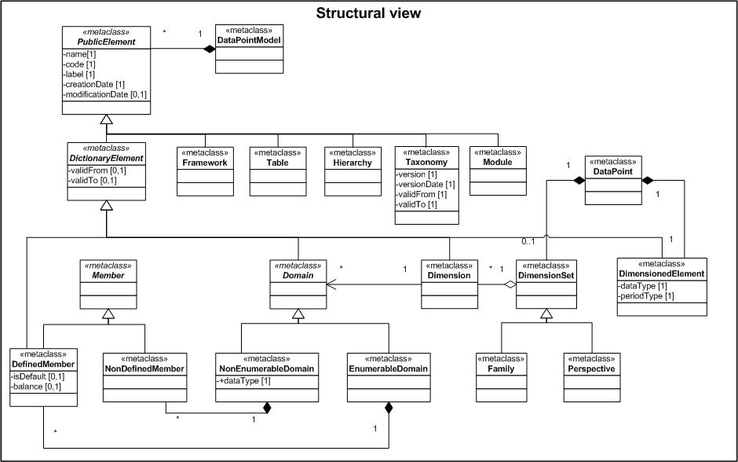
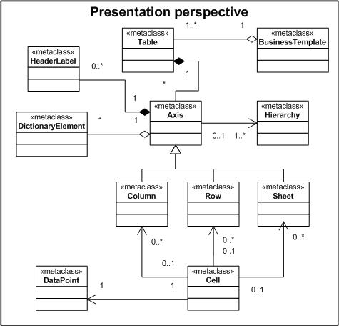
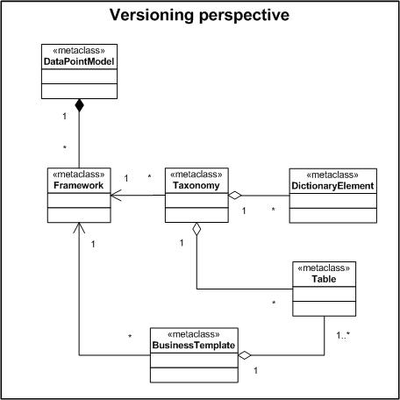
UML Meta model for DPM
Perspectives on the DPM Meta Model
  Structural
  Versioning
  Dimension Validation
  Hierarchical
  Presentation

Slide 17
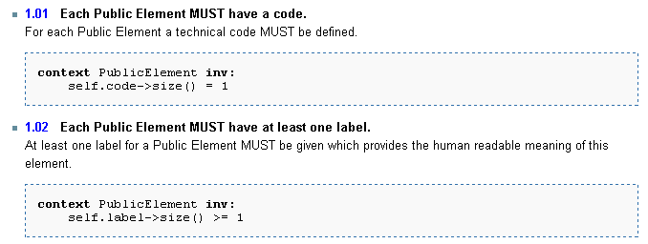
UML Meta model for DPM
Definition of constraints
General constraints on DPMs
Data warehouse specific constraints
European XBRL Taxonomy specific constraints

Slide 18
UML Meta model for DPM
The DPM Meta Model
  eases the understanding of DPMs for IT experts by using the standard modelling language UML,
  reduces the complexity of DPMs by showing only the relevant aspects,
  provides syntax and semantics to ease the automation of IT tasks
    like generating data formats for the reporting process or
    validation checks on basis of the constraints defined,
  enables the derivation of a database design (relational as well as multidimensional).

Slide 19
DPM - Cookbook
Background for the development
  Process of DPM to be conducted by supervisory experts
  Description needed to understand the process and ease the creation of a DPM
  Change in concept of data modelling – away from a presentational perspective to a semantic way of describing reporting data
  Prevent redundancies
  Lower maintenance efforts

Slide 20
DPM - Cookbook
What does the DPM cookbook provide:
  Description on the concept of Data Point Models
    Multidimensionality
    Comparison to presentational approach
    Benefits
  Explanation of the process of Data Point Modelling
    Normalisation of data (definition of dimensions)
    Linkage to existing structures (common dimensions)
    Technical constraints because of XBRL mapping
  Illustrative example leads through the different aspects
  Outlook on possible software product(s)

Slide 21
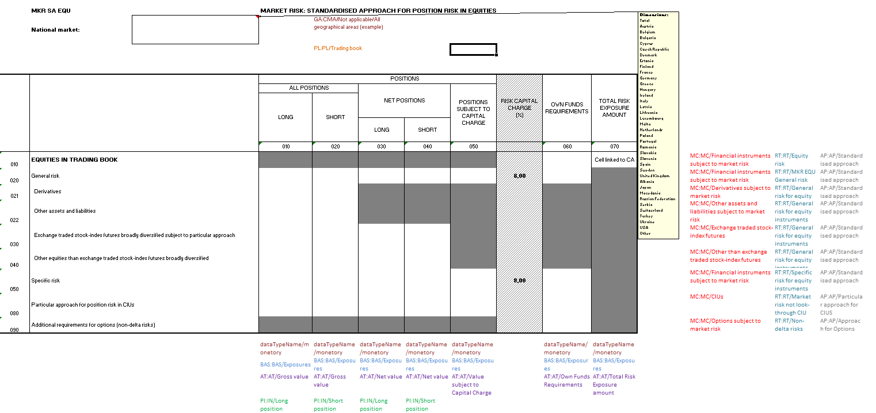
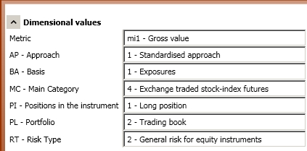
DPM - Cookbook
Example: Annotated COREP template for MKR SA EQU
Data Point
r30c10
A Data Point as a financial concept is characterized by defining its basic financial meaning (nature) and specifying information of breakdowns in which it is described in different tables or paragraphs of documentation.

Slide 22
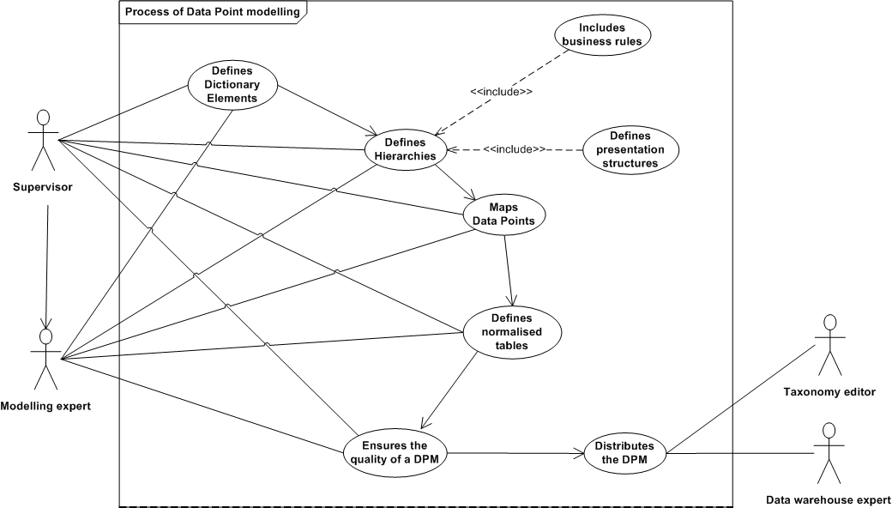
DPM - Cookbook
Process of Data Point Modelling

Slide 23
EXTA- European XBRL Taxonomy Architecture
Description of the EXTA based on the publication of the EBA
  Definition of concept definitions of the dictionary
  Description of the reporting layer
    Framework
    Taxonomy
    Modules
    Tables
    Validations
  Distinguishing between cross-sector, European and national taxonomies
  Providing folder structure and namespace definitions

Slide 24
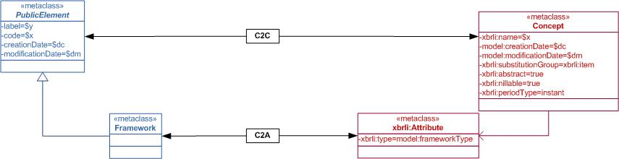
EXTA- European XBRL Taxonomy Architecture
2. Visualisation of the mapping between DPM and XBRL:
  UML graph transformations providing additional describing information by an abstract transformation syntax
  Formal representation of the mapping by extending UML
  Taking the XBRL Abstract Model 2.0 (PWD) into account
  Should ease the understanding for software developers

Slide 25
EXTA- European XBRL Taxonomy Architecture
3. Description for the creation of extension taxonomies:
  Listing of types of extensions
  Provision of extension use-cases and pattern based on
    the different dictionary elements,
    The elements of the reporting layer.

Slide 26
Next steps
Integration of the review results on the published documents (June 2013)
Creation of a non-normative document for mapping between DPM/XBRL and ROLAP

Slide 27
Thanks for your attention
katrin.heinze@bundesbank.de
Comments or questions?
Page 27
CWA1
Notes:
27

