Slide 1
Supervisory reporting in Belgium
Wednesday 19 June 2013, London
Mark CREEMERS
Statistics Department
Money and Banking Statistics

Slide 2
Institutional aspects - overview
01/01/2004
01/04/2011
National Bank of Belgium
* Macro-prudential stability
National Bank of Belgium
* Macro-prudential stability
National Bank of Belgium
* Macro-prudential stability
* Micro-prudential banks
* Micro-prudential insurance
Insurance supervisor
* Micro-prudential insurance
Banking, Finance and Insurance Commission
* Micro-prudential banks
* Micro-prudential insurance
* Financial markets integrity
Financial Services and Markets Authority
* Financial markets integrity
* Consumer protection
Banking and Finance Commission
* Micro-prudential banks
* Financial markets integrity

Slide 3
Institutional aspects - NBB
BANKS: Close collaboration between central bank and banking supervisor since 01/01/1993.
  Integrated reporting scheme (statistics-prudential)
  Centralised collection and validation
    Statistics department "service provider" for colleagues from prudential supervision
    One technical expert team is more efficient, prudential supervision can focus on "content"
    Reporting agent: one collection application, one interface, one reporting protocol, one point of contact...
Collect
Statistics
Validate II / Analysis
Validate I
Prudential
Validate II / Analysis

Slide 4
Institutional aspects - NBB
BANKS: Introduction of FINREP, COREP and XBRL did not change the centralised collection / validation
    Statistics department "service provider" for colleagues from prudential supervision
    One technical expert team is more efficient, prudential supervision can focus on "content"
    Reporting agent: one collection application, one interface, one reporting protocol, one point of contact...
INSURANCE: Same approach will be followed from Solvency II onwards...
Collect
Statistics
Validate II / Analysis
Validate I
Prudential
Validate II / Analysis

Slide 5
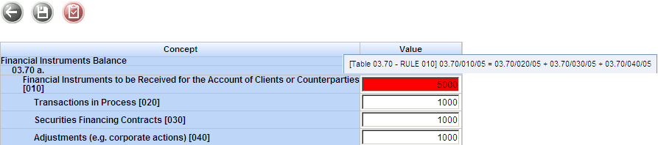
Prudential reporting process - XBRL
OneGate as collection tool: full front-end validation
==> Reporting agent is responsible.
OneGate look-and-feel "XBRL" ~ "non-XBRL"
Taxonomy = holy bible, backbone of whole chain
  Only XBRL-valid input (data entry, CSV, XBRL)
    ==> Data entry / CSV only for very small companies
  Output for BackOffice = XBRL files + control panel

Slide 6
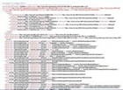
Prudential reporting process - XBRL
XBRL taxonomy
New taxonomies based on DPM
  Complexity and dimensions increase
  Two major "shortcomings" solved
VALIDATION RULES
==> Formula Linkbase
{r330} = {r020} + {r160} + {r300}
{c020} + {c030} <= {c010}
if {c020} != 0 then {c030} != 0
VISUALISATION/MAPPING
==> Table Linkbase
 | Domestic | EMU | RestOfWorld | Total
Current Assets |  |  |  |  | 1 | 2 | 3 |  | 5
NonCurrent Assets |  |  |  |  | 1 | 2 |  | 4
Total Assets |  |  |  |  | 1
 | 6 | 6 | 6
 |  |  |  | 7
 |  |  |  | 8
 |  |  |  | 9

Slide 7
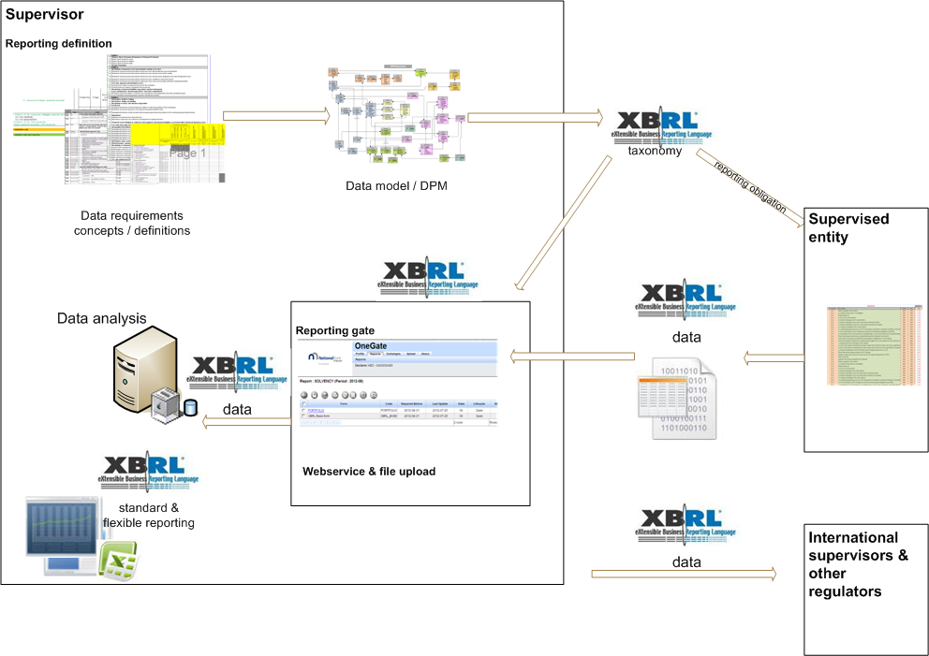
Taxonomy driven flow and analysis
Notes:
7

Slide 8
Questions?
Mark.Creemers@nbb.be
Head of Money and Banking Statistics Division
National Bank of Belgium
Tel: 0032.2.221.55.58

