Slide 1
EBA CRDIV and COREP/FINREP
Harmonization for Europe
Andreas Weller, Head of IT EBA

Slide 2
CRDIV
The CRDIV Implementing Technical Standards will significantly change the XBRL landscape in the banking sector, across the EEA, on the 1st Jan 2014

Slide 3
CRDIV
Implementing Basel III Europe: CRD IV package
The overarching goal of the so-called Basel III agreement and its implementing act in Europe, the so-called CRD IV package, is to strengthen the resilience of the EU banking sector so it would be better placed to absorb economic shocks while ensuring that banks continue to finance economic activity and growth.
18th floor
Legislation and corrigendum

Slide 4
ITS
Implementing technical standards
The text of the ITS
The Data Point Model
And what we have more:
A network of national experts
Taxonomy COREP and FINREP
Version 2.0.0
Eurofiling
EIOPA Solvency II
The NSA’s
18th and 20th floor

Slide 5
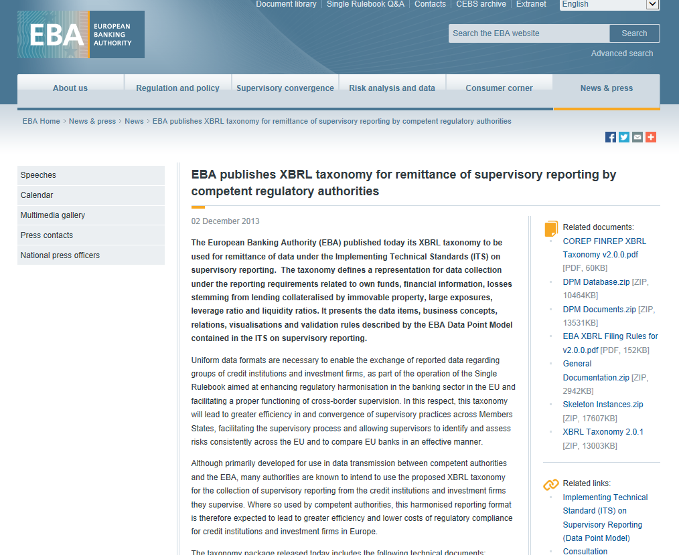
Taxonomy COREP and FINREP

Slide 6
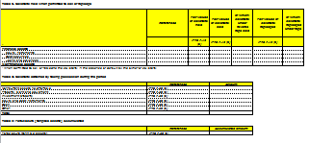
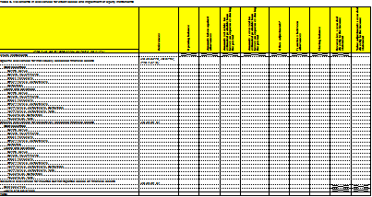
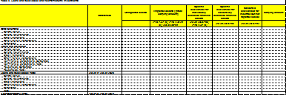
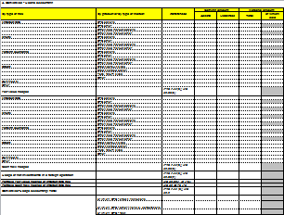
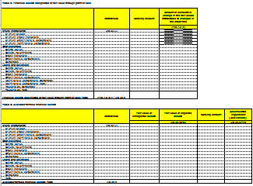
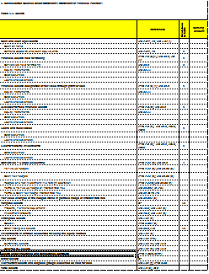
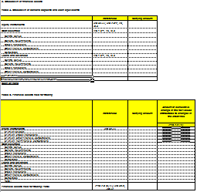
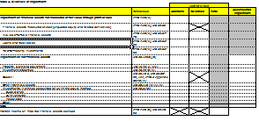
Taxonomy COREP and FINREP
The taxonomy defines a representation for data collection under the reporting requirements related to:
- own funds
- financial information
- losses stemming from lending collateralised by immovable property
- large exposures
- leverage ratio
liquidity ratios

Slide 7
Taxonomy COREP and FINREP
Although primarily developed for use in data transmission between competent authorities and the EBA, many authorities are known to intend to use the proposed XBRL taxonomy for the collection of supervisory reporting from the credit institutions and investment firms they supervise.

Slide 8
The conception phase is over
The work in EBA will move now down to the 9th floor
The phase of the load will start.
We expect to receive now:
- Harmonized EEA Data
- Quality EEA Data
- Consistent EEA Data

Slide 9
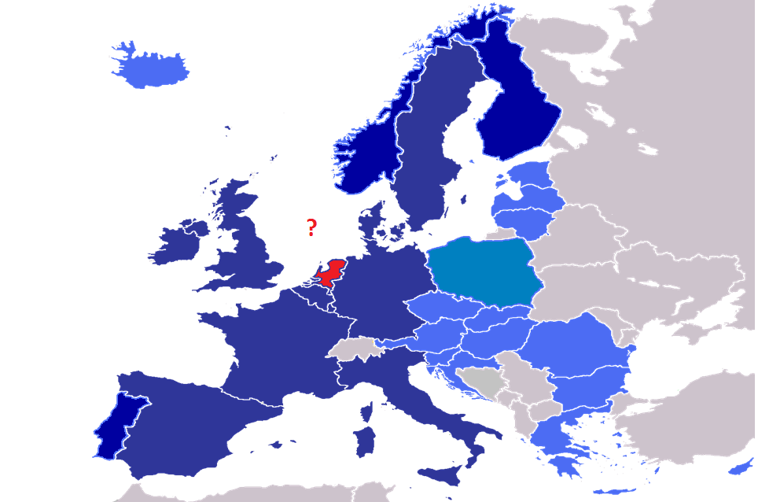
The LOAD phase is starting

Slide 10
Where is the complexity in reporting
Is it the uncertainty of what needs to be delivered?
Is it the ITS and the complexity of data?
Where can XBRL help
And where can the ITS package help you.
Has EBA deployed too many features and
stressed the tools to the maximum?

Slide 11
Accept the challenge
NSA’s, Software vendors, Consultancy companies, Credit Institutions,…. on the load.
Maximise your return of invest with reuse of XBRL data and definitions which are given to the market with COREP and FINREP.
New regulations will come and behind will be DPM and XBRL.

Slide 12
To move forward and be on the save side for the load
Have a clear and accurate interpretation of European Banking Authority (EBA) data definitions in the ITS.
b) Understand technical points and complexities of Data Point Model versus individual reporting.
c) Addressing data management issues by designing business processes to handle increases in data volume and complexity.
d) Creating robust validation rules to deliver the requested data quality.
e) Enable vendor management to produce final outputs from source IT systems in XBRL.
f) Understand IT infrastructure limitations to handle future changes to EBA .

Slide 13
Tower 42 is higher as the XBRL Tower in London.
42 Levels compared to 8 levels.

