Slide 1
EIOPA EUROFILING DAY
10 December 2013
Luxemburg

Slide 2
Context of latest EuroFiling day
An uncertain world …
Uncertainty on Solvency II …
“Omnibus II” Trialogue discussions suspended, pending EIOPA report on long term guarantees
Leading to uncertainty on timing and content
EIOPA consultation on preparatory guideline running
Including a supporting DPM and taxonomy
EIOPA to make available a tool for undertakings to enable submission of information using XBRL in time for preparatory phase

Slide 3
Mid-year expectations
Post consultation update of DPM/Taxonomy (end of year)
A subset of the unique Solvency II taxonomy, not a different one (e.g. using entry points)
Tool for Undertakings: availability planned for end of 2013

Slide 4
Since then … (1)
EIOPA report on long term guarantees delivered (June)
Trialogue discussions resumed
Political agreement reached in November
Omnibus II proposal published
“Quick fix 2”: Entry in force of Solvency II 1/1/2016

Slide 5
Incidence on reporting
Of timing
First regular report Q2 2016 (on Q1 2016)
Possible day-0 (1/1/2016) report
Lighter than an annual report
Ad-hoc. XBRL ?
Of Omnibus II dispositions
Currently being analyzed
Final outcome depends on
Formal adoption of Omnibus II (Parliament)
Availability of implementing measures proposals (COM)
Expected availability: around summer 2014

Slide 6
Since then … (2)
Guidelines published on the 1^{rst} of November, in 23 languages
Electronic format (for quantitative & qualitative)
One preparatory quarterly report (Q3 2015)
Submission (individual) : 25 November 2015 (+8 weeks)
Submission (group): 6 January 2016 (+14 weeks)
One preparatory annual report (Year 2014)
Submission (individual): 3 June 2015 (+22 weeks)
Submission (group): 15 July 2015 (+28 weeks)
Draft translated Annex II files available to supervisors
Public availability, post quality checking
Comply or explains process currently running

Slide 7
Incidence on reporting
Supporting DPM and taxonomy published
Subset of the final one
Some feedback received
Short release cycle envisaged
Update of the preparatory material subset
Scope extension(s) up to the comprehensive one

Slide 8
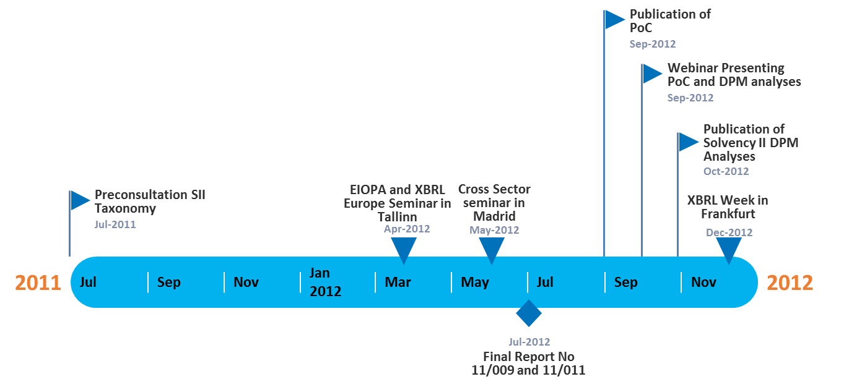
2012 Taxonomy Timeline

Slide 9
2013 Taxonomy Timeline
Publication of the updated version of DPM and Taxonomy for the Preparatory Phase
Publication of the Consultation version of DPM and Taxonomy for the Preparatory Phase
Nov-2013
Publication of the updated version of DPM and Taxonomy for the Preparatory Phase
PoC: MD for Open Tables
First internal draft full set SII templates
Mar-2013
EIOPA Reporting Seminar
Frankfurt
Jul-2013
Oct-2013
Dec-2013
2013
2013
Jan
Feb
Mar
Apr
May
Jun
Jul
Aug
Sep
Oct
Nov
Dec
2013
Mar-2013
Nov-2013
Publication of the SII Preparatory GL
CP-13/010
Publication of the Preparatory GL

Slide 10
2014 Taxonomy Timeline
May 2014:
Publication of the Final Preparatory SII DPM and XBRL Taxonomy
Publication of the Manual for Fillers
Publication of the Manual for NSAs
Confirmed
February 2014:
Candidate release of the Preparatory SII DPM and XBRL Taxonomy
Candidate release of the Target SII DPM and XBRL Taxonomy, following the EIOPA Business Timeline for SII Reporting requirements
April 2014: Candidate release of the Target SII DPM and XBRL Taxonomy, following the EIOPA Business Timeline for SII Reporting requirements
May 2014: Candidate release of the Target SII DPM and XBRL Taxonomy, following the EIOPA Business Timeline for SII Reporting requirements
September 2014: Publication of the Final Target SII DPM and XBRL Taxonomy – Assuming that the final SII Guidelines will be available by July 2014
To be confirmed – dependent on the EIOPA Business Timeline for SII
2014
Jan
Feb
Mar
Apr
May
Jun
Jul
Aug
Sep
Oct
Nov
Dec
2014

Slide 11
Taxonomy November release
Nov-2013
Covering:
Latest business requirements updated mid-October covering: Solo, Group, Quarterly, Annual, Public Disclosure.
DPM update incorporating the latest changes approved by SG3 (up until 21/08/2013)
Subset of assertion formulas
Filing indicators updated to match the latest version
Use of 2013-05-17 (“Dublin”) PWD version of the Table Linkbase specification
HD and MD layer (coded prototype conversion included in the Nov.4 release)
Updated technical documentation
Preparatory SII DPM and XBRL Taxonomy

Slide 12
Taxonomy December release
Dec -2013
Covering:
Primary focus on Bug Fixing
Improve documentation
Provide Release Notes documentation
PoC: MD approach for Open Tables
NB. This will not contain any assertion formulas
Preparatory SII DPM and XBRL Taxonomy

Slide 13
Pro and cons for dimensional XBRL taxonomies
Pros of XBRL HD models
High quality of the model
Explicit dependencies between concepts
Change management with stable Metrics
Use of breakdowns for internal purposes (databases, BI…)
Potential bridge with other reporting frameworks
No need for arbitrary decisions (Metrics vs. Dimensions)
Data centric model (template independent)
Pros of XBRL MD models
More readability of taxonomies
Smaller instances and better performance (less breakdowns used)
Less complex formulas / assertions with requirement to use dimension filters

Slide 14
XBRL. The two layers approach. Example of improvements done for S2
Cross-sector
Solvency 2 – Common
Solvency 2 – Highly Dimensional
Solvency 2 – Moderately dimensional
dictionary
templates
analysis
conversion
reporting
Slide source: BR-AG.

Slide 15
PoC Taxonomy December release
Dec -2013
For Open tables, data points which were captured as dimensions in HD and facts in MD will now be consistently captured as dimensions.
This means there will be fewer facts for MD open tables but those facts will have more dimensions in their (shared) context.
Advantages
Simpler conversions
More understandable MD model
Elimination of bugs caused by inconsistencies in this area
Potentially smaller instance sizes
Preparatory SII PoC DPM and XBRL Taxonomy

Slide 16
Reporting Tool for Undertakings.
Greater harmonisation and coherent application of rules for financial institutions & markets across the European Union.
Adoption of open and free Data Point Model methodology, used by EBA and ECB, in order to explicitly, precisely and unambiguously describe Solvency II supervisory information requirements.
DPM
Adoption of open, free and globally used eXtensible Business Reporting Language to facilitate electronic transmission of data according to DPM model and governed by advanced XBRL data quality mechanism.
Provision of the Tool for Undertakings to mitigate the risk of undertakings not being able to communicate information to supervisors and in order to mitigate the risk of NCAs not being able to communicate information with other NCAs or EIOPA in a timely and required manner.
T4U

Slide 17
XBRL. The reasons
XBRL has been chosen for the following reasons
Because is the only standard for financial reporting, any other option, or will not fit well with financial reporting needs or will be a (one man)/(one problem) solution
For harmonization having the benefits of economies of scale. Is cheaper and is better to be in the same boat to have the same “not perfect solution” for everybody than 30 different solutions
It solve a number of problems/discussion as is giving a common vocabulary and common artefacts for cross-country and cross-sector reporting
It will be improved with your help

Slide 18
TfU. The expected by end 2013
Should we take other option?
Phase 1 (First analysis)
8.3 Weeks
Phase 2 (Analysis, design and PoCs)
12.9 Weeks
Internal project timeline
Phase 3 Core functionalities construction & testing
13.3 Weeks
Phase 3 Non-core functionalities construction & testing
22.3 Weeks
Obsolete expected timeline delayed
Phase 3 Testing & training
12 Weeks
Legend
First version of the TfU
Internal milestone
TfU contractor's analyses starts
First PoC TfU
First Beta TfU
27-12
External milestone
30-4
18-9
30-10
2013
2013
Mar
May
Jul
Sep
Nov
Jan
Mar
2014
24-3
27-12
External milestones
Publication of the SII Preparatory GL, the DPM and Taxonomy
1-11
Publication of the release candidate of SII Preparatory Reporting Package
Publication of the Preparatory GL and Preparatory Taxonomy

Slide 19
The Tool for Undertakings Project (TfU)
The Goals
Distribution license for all Europe. Preferable EUPL license
Internationalization: Languages, data formats, currencies, etc.
Using the input forms in a similar layout as the public reference templates.
Easy to use for administrative staff with limited IT knowledge
Allowing reusing or extension of the tool for national extensions
Easy to deploy
Use of XBRL label, rendering, reference, formulas, etc.
XBRL syntax and formula validation at client side
2nd level support
Easy to update when the taxonomy changes
Open source,
reusable
Good performance with large amounts of data
Multiplatform
Note that these requirements are under discussion and not final

Slide 20
Options under consideration
Option 1 server and licenced based solution
Option 2 bespoke deployed solution
Decision to be taken end of January by EIOPA’s Board of Supervisor

Slide 21
TfU Option 2 Solution Architecture
DPM
annotated templates
XBRL taxonomy
NCAs
Undertakings
DPM Architect
MS Excel templates / Windows
Forms
Group parent
XBRL report
NCAs
DPM Database (metadata and data)
Data quality / Arelle XBRL validation service
Other formats
EIOPA
XBRL report
Reporting
Data quality check
Data and metadata
XBRL generation

Slide 22
TfU Option 2 Value for undertakings and NCAs
T4U
The Tool for Undertakings (T4U) is a tentative solution aiming to enable small and medium reporting entities as well as European National Competent Authorities to input data using common interfaces and manage data using centralised database, designed to process data structures represented in the EIOPAs Solvency II XBRL DPM-based taxonomy, in order to produce XBRL reports compliant with Solvency II requirements.
Undertakings
NCAs
Help with XBRL technology: capabilities to create and read XBRL instances from a well-known data sources
Help with data validation: capabilities to validate data with XBRL and other alternatives
Help with substantial data volumes: providing alternative structures to create ETL form undertaking’s DWHs
Help with data presentation and data input: capabilities to render and modify data by administrative staff with user friendly interfaces
Help to standardise European supervisory architecture: apply standards common with EBA and ECB
Help with XBRL technology: capabilities to create and read XBRL instances from data submitted by the undertakings to facilitate second-level reporting
Help with data validation: capabilities to validate data with XBRL and other alternatives
Help with substantial data volumes: providing alternative structures to create ETL form undertaking’s DWHs
Help with data presentation and data input: capabilities to render and modify data by administrative staff with user friendly interfaces
Help with data analysis: provide basic BI capabilities
Help with customising / tailoring data scope collected using T4U: extension capability

Slide 23
TfU Option 2 Functions: In and Out of Scope
✓
✓
✗
Easy-to-use with multiple Data Input Interfaces
Generation of XBRL Reports according to Solvency II DPM XBRL Taxonomy (Level 1 & 2)
Reports and submissions management
✓
✓
✗
XBRL Validation (open source component) for Reported Data
XBRL load, validation and creation with database approach
Support for other XBRL Architectures than EIOPA / Eurofiling
✓
✓
✗
DPM Database for Metadata and Data
Generation of XBRL Taxonomy according to Eurofiling Architecture
Adavanced data analysis
✓
✓
✗
Basic BI analysis capabilities
Second-level support
First-level support
/ support services for extensions

Slide 24
TfU Option 2 Tentative Timeline
Scope of requirements definition
11/01/13 - 03/01/14
121 Days
Prototype
12/01/13 - 01/15/14
46 Days
Development
12/02/13 - 05/20/14
170 Days
Stabilize
05/20/14 - 06/20/14
32 Days
Launch
06/17/14 - 06/27/14
11 Days
BoS Decission Go No-go Decision
01/30/14
First Public Beta
Release candidate
Today
03/01/14
05/01/14
2013
Nov
Dec
Jan 2014
Feb
Mar
Apr
May
Jun
2014
12/01/13
01/15/14
06/30/14
Project Kickoff
Alpha Internal Release
Project Development Close

Slide 25
TfU Option 2 Tentative Timeline
Timeline: 01/11/2013 - 30/06/2014
Milestone(s)
Date | Description
12/01/13 | Project Kickoff
01/15/14 | Alpha Internal Release
01/30/14 | BoS Decission Go No-go Decision
03/01/14 | First Public Beta
05/01/14 | Release candidate
06/30/14 | Project Development Close
Task(s)
Duration (Days) | Start Date | End Date | Description
121 | 11/01/13 | 03/01/14 | Scope of requirements definition
46 | 12/01/13 | 01/15/14 | Prototype
170 | 12/02/13 | 05/20/14 | Development
32 | 05/20/14 | 06/20/14 | Stabilize
11 | 06/17/14 | 06/27/14 | Launch

Slide 26
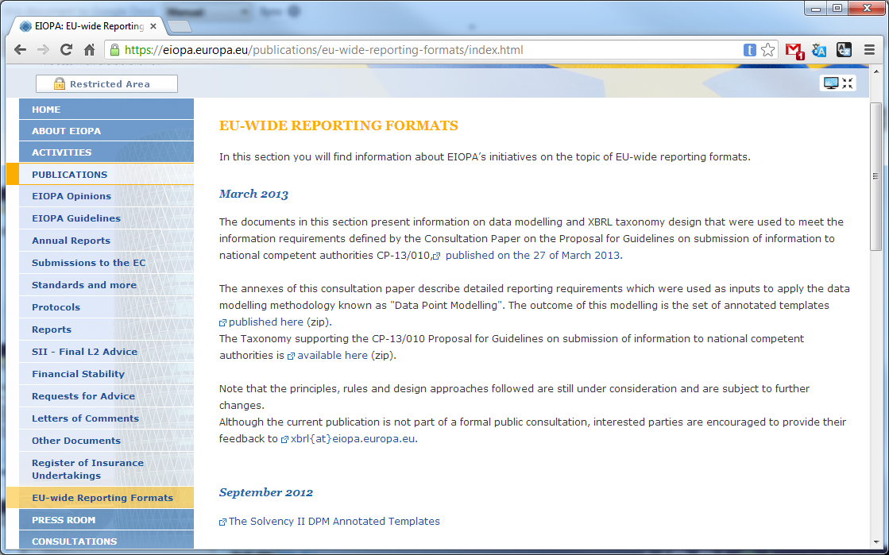
Keeping up to date
https://eiopa.europa.eu/publications/eu-wide-reporting-formats/index.html

Slide 27
Thank you
Pierre-Jean Vouette
Pierre-Jean.Vouette@eiopa.europa.eu
Aitor Azcoaga
Aitor.Azcoaga@eiopa.europa.eu

