Slide 1
EBA Taxonomy And DPM Architect
10 December 2013 | Luxembourg
Owen Jones | CRR Taxonomy Project EBA

Slide 2
Taxonomy in more detail
Particularly areas of interest to users/vendors(“quirks”)
Tables (table linkbase)
Validation rules
DPM Architect
What is it
How does the EBA use it
How can you use it

Slide 3
Table linkbase
The EBA taxonomy makes use of the “table linkbase” specification
This allows the taxonomy to describe the standard tables to be used for reporting, and how they relate to the underlying data, which can then be reproduced by tools for data display or entry.
The spec is still being developed
The 2.0.x version of the taxonomy uses the “Dublin” PWD version
There is now a later CR version of the spec
Eventually there will be a REC version
We will likely adopt the REC version in a future release (2014/2015?)

Slide 4
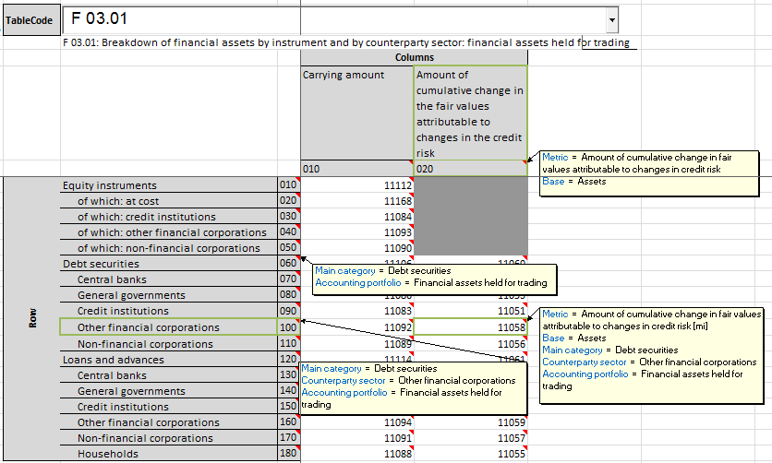
DPM Table descriptions

Slide 5
XBRL Table linkbase
X (col)
Predefined Axis
010
Dimension members
020
Table
030
040
Y (row)
Z (sheet)
Open/Variable Axis
Key Dimension(s)
So Taxonomy is essentially a 1:1 mapping of the DPM
One difference, child row/columns
DPM describes each independently
XBRL style is to inherit attributes from parent

Slide 6
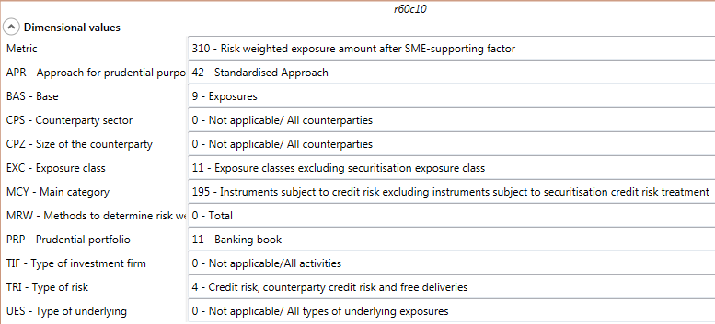
XBRL Tables

Slide 7
A brief word on Table Cells, Data points and Grey Cells
In the DPM
Individual table cells and data points are explicit entities
Individual cells can be explicitly marked as invalid (grey)
In XBRL
Only table axes and dimensions are explicit
The intersections of axes (cells) are simply a result
Intersections of dimensions (data points) are similarly implied
Valid cells specified by “hypercubes” of valid dimension combinations.
Invalid cells are just the left over intersections.
XBRL Hypercubes are purely technical artefacts to indicate grey cells
Can be very arbitrary, No analytical value

Slide 8
Tables vs Templates
The DPM approach models the properties of rows and columns
In some ITS templates, the rows or columns change meaning part way through the table

Slide 9
 | Amount | Outflow
Item | 010 | 020 | 030
OUTFLOWS
part of an established relationship …
held in transactional accounts…
Item | Market value | Where the counterparty is not a central bank
 |  | extremely high liquidity and credit quality assets
 |  | Amount due | Value according to Art. 418 CRR
Liabilities resulting from …
representing claims
guaranteed by

Slide 10
Tables vs Templates
The DPM approach models the properties of rows and columns
In some ITS templates, the rows or columns change meaning part way through the table
The DPM methodology (and XBRL) cannot cope with this
→ we split the template into multiple tables
Examples
C 52.00 → C_52.00.a, C_52.00.b, …, C_52.00.e
C 45.00 → C_45.00.a, C_45.00.b

Slide 11
Accounting Standard
FINREP – IFRS vs GAAP
A few templates are GAAP only – most are shared by IFRS & GAAP
Modelled as “integrated” tables – exactly same table for both
N.B. ITS DPM tables are not the same as the ITS Excel template “pictures”
Reporter is expected to simply know which cells are applicable to them
ITS templates will help reporters identify
GAAP tables are all tricky anyway
GAAP FINREP is based on a “best match” to IFRS concepts
Different GAAPs → different cells that are a “good enough match”
NSAs may be expected to provide guidance?

Slide 12
Types of tables
The frameworks contain several different kinds of tables
Simple two–dimensional tables
Tables with more complex features:
Sheets (z-axes)
Open tables
Open sheets

Slide 13
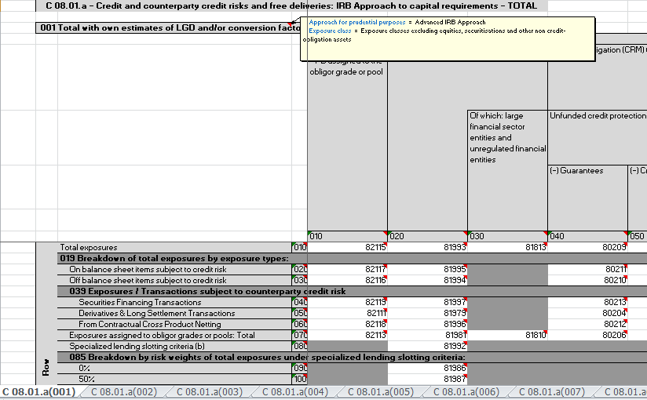
Fixed Sheets - DPM

Slide 14
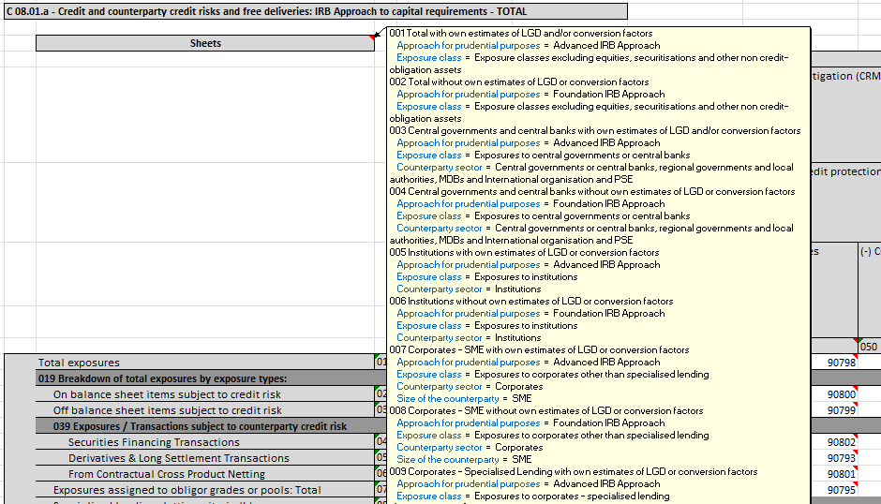
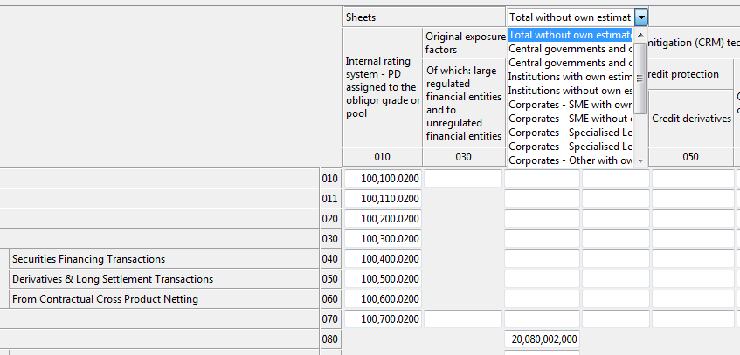
Fixed Sheets - XBRL
Number of options known in advance
All “expected”, non-reported means “zero”
Maps as a simple predefined z-axis, just like rows or columns
Cells on each sheet just have different dimensional properties
Relate to different facts (context/metric)
XBRL software will show e.g. a drop down box to choose a sheet
Fixed sets of currencies/countries are the same (C 18, C 21)

Slide 15
Open tables – Rows

Slide 16
Open tables – Rows
These map to an “Open Axis”
Number of entries unknown/unlimited
Linked to one (or more) “typed” dimensions (number, string etc.)
In the DPM
each repeated cell has exactly the same data point ID
data point has a dimension with value “999”
In XBRL
“scenario” of context contains a typedMember value:
<xbrldi:typedMember dimension="eba_dim:LEC"><eba_typ:LE>a</eba_typ:LE></xbrldi:typedMember>
Easy to identify

Slide 17
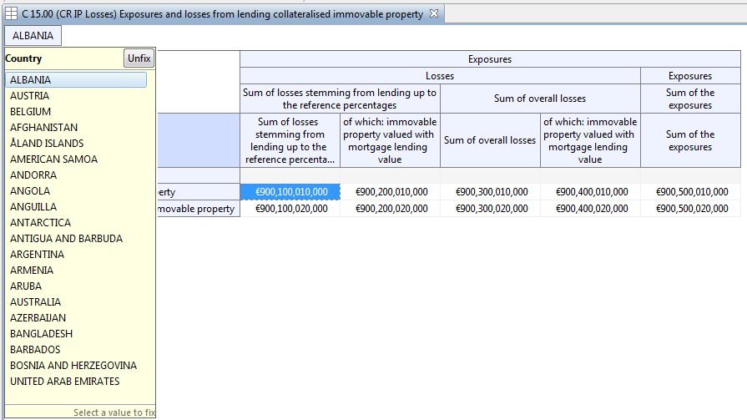
Open tables – Sheets – DPM and XBRL rendering

Slide 18
Open tables – Sheets
Used where “some” options from a list should be reported
e.g. Top 10 countries by exposure, “significant” currency holdings
Non-reporting does NOT mean “zero”.
In the DPM
each repeated cell has exactly the same data point ID
data point has a dimension with value “999”
In XBRL
Choices are known (e.g. countries), so maps to an explicit domain
“scenario” of context just contains another explicit domain value
<xbrldi:explicitMember dimension="eba_dim:CEG">eba_GA:PL</xbrldi:explicitMember>
Easy when creating instances, watch out when reading them

Slide 19
XBRL Instance
DPM
Fact
Metric
Value
Dimension Values
Unit
Accuracy
Data point
Table Cell
Normal
dimension
Context
Entity
Key Dimension (“999”)
Period/Instant
“open” country or currency
Explicit Dimensions
Typed Dimensions

Slide 20
Purpose of Validations
XBRL validation formulae:
Communicate the rules unambiguously
Allow filer to independently check data before submission
Drive a step change in reporting quality
Not a magic bullet:
Cover only the groundwork of basic validity checking
Lots of data quality issues left for CA/EBA processes!

Slide 21
Validations

Slide 22
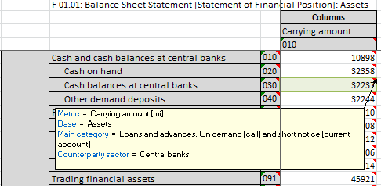
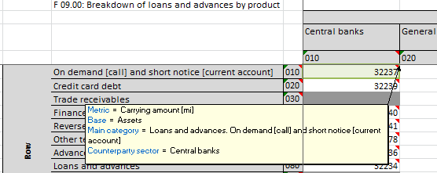
Identities
e.g. {F 01.01 , r030, c010} ≡ {F 09.00 , r010, c010}
Cells that refer to exactly the same piece of information. They share exactly the same DPM categorisations.

Slide 23
Identities - Mapping to XBRL
In XBRL (within a single reporting instance) these are intrinsic
Both cells are represented by the same fact
The value is only reported once
If using the table linkbase, fill in one cell and the other will show the same value automatically
But
Some identities cross reported instances (modules or frameworks)
These are NOT handled in XBRL
These checks will be handled by wider NSA systems/processes.

Slide 24
XBRL Formulae
All other rules are expressed as XBRL formula assertions
The definition of the rules are Form centric (refer to table cells)
+ Easier for business users to define and review
- Not particularly suited to DPM or XBRL formats

Slide 25
Quick Intro to XBRL Formula
Assertions consist of
Rule expression
Arbitrary XPath expression (basically an equation),
e.g. $a = $b + $c
Variables
E.g. $a
Filters (Variable and Global)
Give properties facts must have to be assigned to a variable
Preconditions
Conditions that must be true for the validation rule to evaluate

Slide 26
Formula Intro - Example
“(Row 1-4) C1 = C2 + C3”
 | 1 - Assets | 2 - Current | 3 - Fixed
1 – France
2 – Germany
3 – Spain
4 - All

Slide 27
Formula Intro – XBRL representation
“(Row 1-4) C1 = C2 + C3”
→ $a = $b + $c
 | Metric | Carrying Amount | Carrying Amount | Carrying Amount
 | AssetType | Assets | Current Assets | Fixed Assets
Country |  | 1 - Assets | 2 - Current | 3 - Fixed
France | 1 – France
Germany | 2 – Germany
Spain | 3 – Spain
 | 4 - All
Global Filter : [Metric = Carrying Amount]
Filter on a : [AssetType = Assets]
Filter on b : [AssetType = Current Assets]
Filter on c : [AssetType = Fixed Assets]

Slide 28
Evaluation - Filtering
→ $a = $b + $c
“(Row 1-4) C1 = C2 + C3”
 | Metric | Carrying Amount | Carrying Amount | Carrying Amount
 | AssetType | Assets | Current Assets | Fixed Assets
Country |  | 1 - Assets | 2 - Current | 3 - Fixed
France | 1 – France
Germany | 2 – Germany
Spain | 3 – Spain
 | 4 - All
Global Filter : [Metric = Carrying Amount]
Filter on a : [AssetType = Assets]
Filter on b : [AssetType = Current]
Filter on c : [AssetType = Fixed]

Slide 29
Evaluation – Implicit Matching
“(Row 1-4) C1 = C2 + C3”
→ $a = $b + $c
 | Metric | Carrying Amount | Carrying Amount | Carrying Amount
 | AssetType | Assets | Current Assets | Fixed Assets
Country |  | 1 - Assets | 2 - Current | 3 - Fixed
France | 1 – France | $a | $b | $c
Germany | 2 – Germany | $a | $b | $c
Spain | 3 – Spain | $a | $b | $c
 | 4 - All | $a | $b | $c
Filter on a : [AssetType = Assets]
Filter on b : [AssetType = Current]
Filter on c : [AssetType = Fixed]
Global Filter : [Metric = Carrying Amount]
N.B. One rule, four checks

Slide 30
Types of formula rules
Sign
Hierarchies
Manual
Allowed values type (Enumerations)
Coherence checks

Slide 31
Sign
e.g. {C 07.00.c, r290,c030} <= 0
Simply indicate that a particular cell (or range of cells) must have a particular sign, i.e. whether they must be positive or negative
Few rules, each rule can cover large swathes of a table
(Note strange looking rules like “{C 07.00.c}>= 0”, where the scope of the rule covers rows and columns)
Notes:
Why rules rather than data types?
Data type problems tend to get thrown by xml parsing, output and interpretation of errors by tools is tricky.
Data types are pretty fundamental – correcting a mistake is tricky, and causes more change in the production process.

Slide 32
Hierarchies
Rules are produced automatically from the hierarchies of members specified in the DPM for domains of values.
e.g. One of the hierarchies for the “Approach” domain states that
“Standardised approaches for commodities risk”
= ( “Maturity ladder approach”
+ “Extended maturity ladder approach”
+ “Simplified approach” )
Looking for places in the tables this might apply leads to the rule:
C 23.00 - Columns (010-060): {r010} = {r080}+{r070}+{r090}

Slide 33
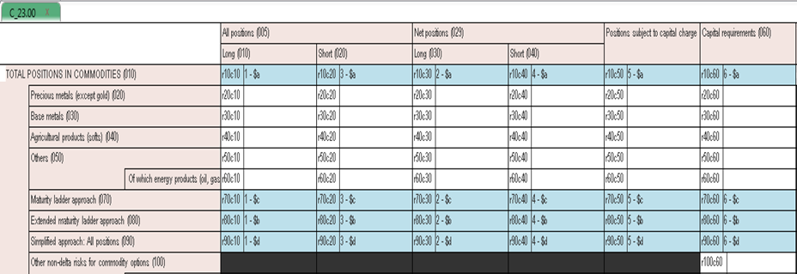
Hierarchies
e.g. C 23.00 - Columns (010-060): {r010} = {r080}+{r070}+{r090}
XPath expression $a = $b + $c + $d

Slide 34
“Manual” rules
These are rules that have been written by hand by business experts, e.g. :
C 07.00.a : {r150,c215} = {r150,c200} * 2%
C 16.00.a : if {r010,c010} > 0 or {r010,c020} > 0 then {r010,c070} > 0
C 25.00 (r020) : {c080} = max(c040}, {c050}) + max({c060},{c070})
F 02.00 (c010) : {r520} = sum(r530-570)
Also cross table rules like
{C 42.00, r070,c010} = {C 45.01, r150,c030} + sum({C 01.00, c010, (r800, r842, r930-950)})

Slide 35
“Manual” rules - syntax
Normal algebraic expressions, most XPath functions allowed (max, abs, if …)
Cell/column/row/sheet references
{C 45.01, r150, c030, s001} and variations
Sums
sum({C 01.00, c010, (r800, r842, r930-950)})
sum({C 06.00, c100,(rNNN)}) – open table
Each formula can be applied to a set of rows, columns or sheets
The formulae are simply translated to real XPath for XBRL

Slide 36
xsum
“xsum(r2,r4,c1,c3)”
r2,r4
 | 1 - Assets | 2 - Current | 3 - Fixed
1 – France
2 – Germany
3 – Spain
4 - All
 | 1 - Assets | 2 - Current | 3 - Fixed
1 – France
2 – Germany
3 – Spain
4 - All
 | 1 - Assets | 2 - Current | 3 - Fixed
1 – France
2 – Germany
3 – Spain
4 - All
 | 1 - Assets | 2 - Current | 3 - Fixed
1 – France
2 – Germany
3 – Spain
4 - All
c1,c3
xsum is the “sum of the intersections”

Slide 37
Multiple-choice values (Enumerations)
Some table cells should be reported as one of a set of values
e.g. “Group structure relationship” = “Associates” or “Joint ventures” or “Subsidiaries”)
IN XBRL
Values listed as domain members
Metrics implemented with “QNameItem” datatype
e.g. <eba_met:ei316 contextRef="c2">eba_ZZ:x27</eba_met:ei316>

Slide 38
Enumerations in XBRL
XBRL does not (yet) have a standard mechanism to indicate which values are allowed
We have used :
Modelling - Custom annotation on metric to link to allowed values
e.g. model:domain="eba_exp:RP" model:hierarchy=http://www.eba.europa.eu/xbrl/crr/role/dict/dom/RP/RP2”
Checking - XBRL formulae to check only permitted values used
E.g. $a = (xs:QName(‘eba_RP:x11’), xs:Qname(’eba_RP:x3’), xs:Qname(’eba_RP:x1’))
Notes:
There is a mechanism at the XML level, but for various reasons there are disadvantages to using this in XBRL
Mostly schema validation failures tend to be handled in a dramatic, stop–dead fashion,

Slide 39
Enumerations
XBRL representation
“eba_ZZ:x27” is not very helpful…
Opportunity for tool developers
Utilise the EBA metadata to show textual labels, provide drop down lists etc.
E.g. “I - Institutions”, ”U – Unregulated financial entities”
Future direction
XBRL standards in this area are being designed
Will likely adopt them when they are finalised
In parallel with existing mechanism if at all possible

Slide 40
Representation of rules
(Same) Rules expressed in three formats:
Plain text – ITS Annex XV – Spreadsheet
Structured – DPM – Database
Formal – Taxonomy – XBRL

Slide 41
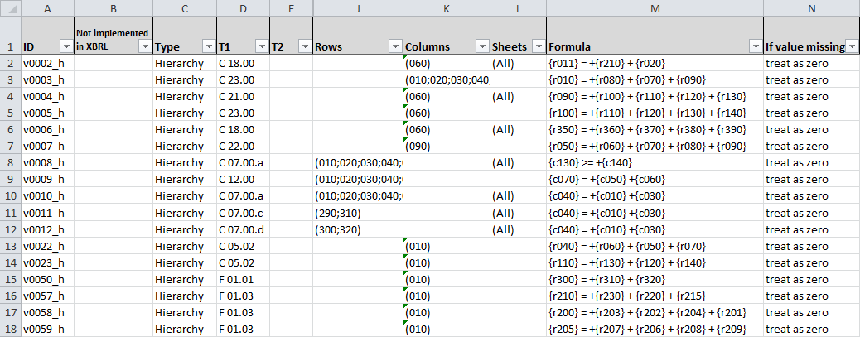
Representations – Rule Spreadsheet (Annex XV)
Notes:
Not implemented
ID
If value missing
Tables
Type

Slide 42
Representations – Rule Spreadsheet (Annex XV)
Primary format for specification and review by business experts
Custom syntax, looks a bit like Excel formulae
Will be the best input for many custom implementations.
Includes some rules that are not mapped into DPM/XBRL
these should be handled by NSA systems/processes.
Each rule has a unique ID that links it to the DPM and XBRL representations

Slide 43
From spreadsheet rules to the XBRL
Spreadsheet → DPM Database
Decompose rule, adding structure and relations to rest of DPM model
DPM Database → XBRL
Express in XBRL technical syntax

Slide 44
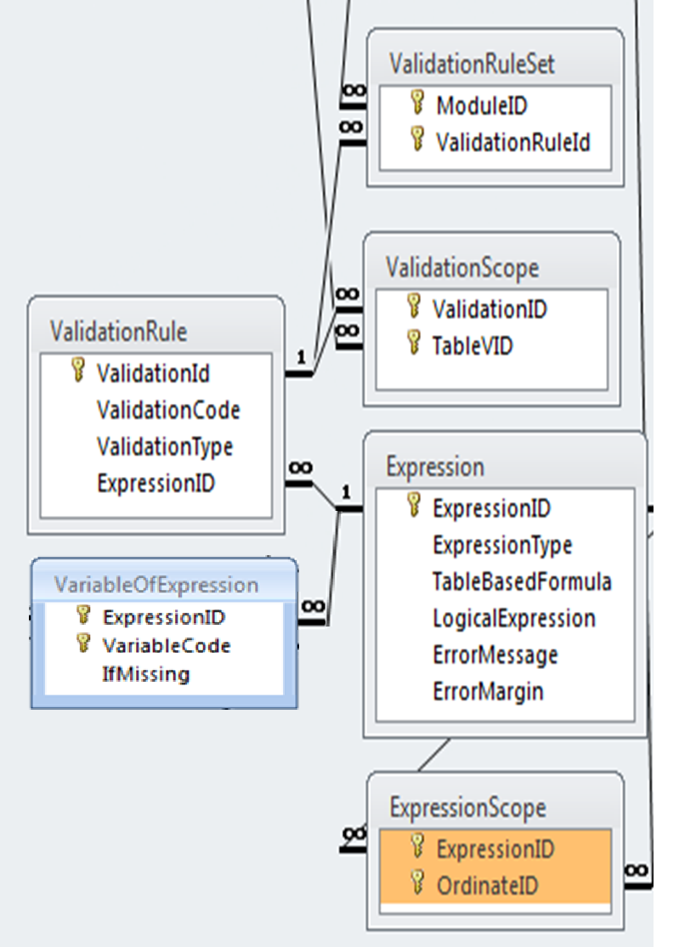
Representation – Database → XBRL
Identifies with which modules the rules is associated (linked by).
Rules for common table sets are grouped into assertion sets.
Each rule has preconditions based on filing indicators for required tables.
“Table based formula” from spreadsheet → “LogicalExpression”,the XPath expression used in XBRL.
Rule has filters to restrict evaluations to these ordinates.

Slide 45
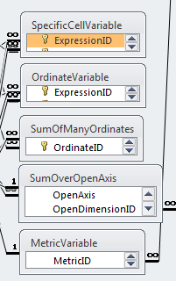
Representations – Variables
{C 45.01, r150, c030, s001}
$a – filter sufficient to pinpoint a data point
{C 45.01, r150}
$a – filter to a column/row/sheet
sum({F 15.02, (c010-030)}),
xsum({F 05.01.a, (r210, r260, c010-030)})
sum($a) – bind as sequence, combine ordinate dimensions with OR
{C 10.01, r020} = sum({C 10.02, (rNNN)}),
sum({C 09.02, r130, c090, (sNNN)})
sum($a) – bind as sequence, cover the axis dimension
[Type of counterparty] ∈ {[I-Institutions],[U-Unregulated entities]}
Filter on Primary Item = eba_met:ei316
$a = ([eba_ZZ:x27], [eba_ZZ:x28])

Slide 46
Practical Reality
There is a wide variety of types of institution / situation
The regulations are new
There is a huge amount of data, and so a lot of rules
→ Lots of potential for errors to slip through
So, even though the validation rules only cover very simple checks
We may (will) find problems
These will need to be resolved quickly to facilitate filing

Slide 47
Practical Solution
“Disable first – correct later”
The EBA will regularly publish a list of validation rules that are under investigation and should be “ignored”.
Subsequent releases of taxonomies will then correct or remove rules as appropriate.
Reporting processes and tools should be designed to with this in mind.

Slide 48
DPM Architect – What is it?
A software tool for
The definition of financial models,
based in XBRL,
according to the European Taxonomy Architecture
Developed by the Banco de España

Slide 49
DPM Architect – What is it useful for?
Used by the EBA as part of our taxonomy production process
Useful for everyone to review and explore the EBA taxonomy
Potentially useful for Competent Authorities who want to
tweak
extend
complement
the EBA Taxonomy

Slide 50
Taxonomy Development: Iterative Process
Templates
Analysis
Modelling
Structure
checks
Validation Rules
DPM Excel
Metadata
loading
SAS,C#
Quality
checks
DPM Database
Metadata
extraction
C# Plugin
DPM
Architect
Generation
Implementation
Advice
Taxonomy Architecture + Mapping approach
XBRL Taxonomies
Testing and Feedback

Slide 51
Use by the EBA
Our taxonomy development process involved:
Lots of subject experts defining templates and data models
A huge data model
Lots of changes, adjustments and refinements to the underlying reporting requirements
Starting point for co-ordination of the experts and information capture is an Excel Spreadsheet.
SAS code and DPM Database used to provide logical checking and feedback.
Actual production of the taxonomy is only a small part of the work

Slide 52
Use by the EBA
DPM Architect is used in the final XBRL output
Used primarily as an XBRL writing API
An EBA developed custom plugin:
extracts data from the DPM Database
Builds an in-memory model in the tool
DPM Architect then saves the model as XBRL

Slide 53
What does this mean?
The taxonomy could theoretically be created by hand using DPM Architect
More importantly
It is possibly a perfect tool to visualise, understand and review the EBA taxonomy
it presents things in the way we were thinking about them

Slide 54
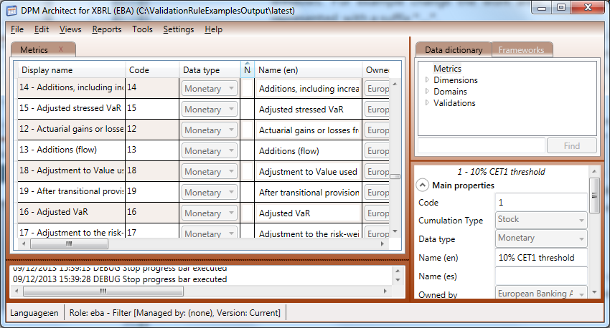
What does it look like?
Notes:
Main area
Navigation are
Property area
Messages

Slide 55
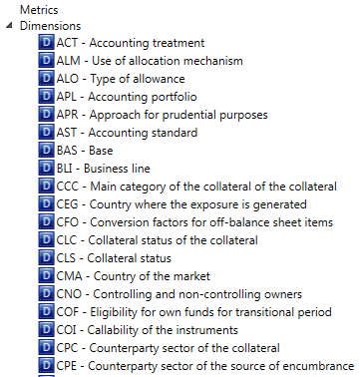
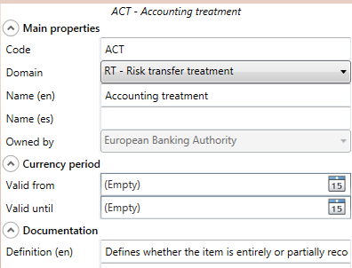
Dimensions

Slide 56
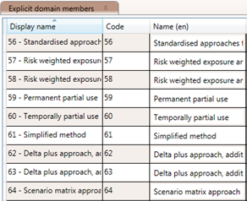
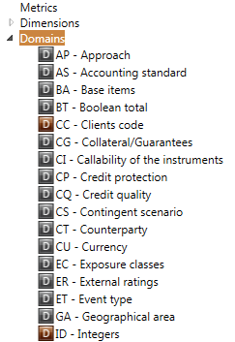
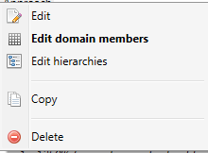
Domains

Slide 57
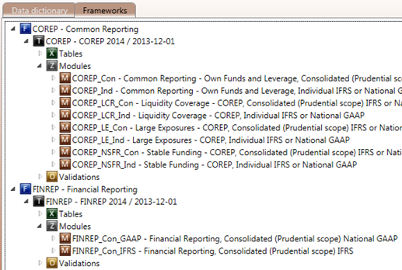
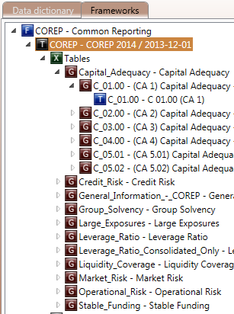
Modules (reports), Table groups and tables

Slide 58
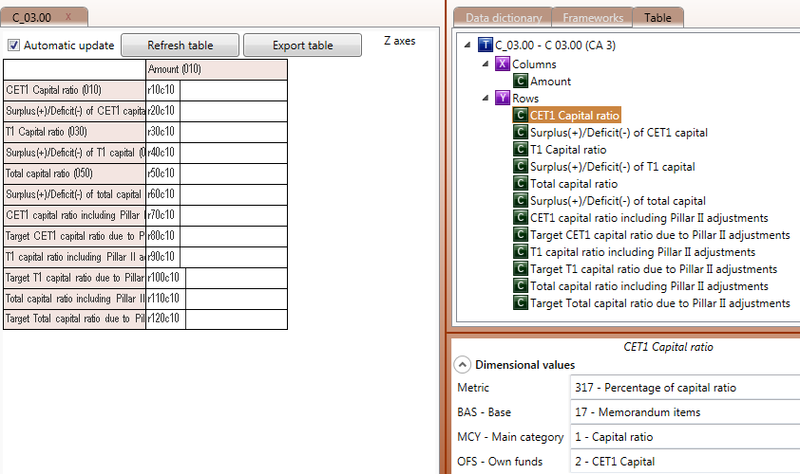
Table layouts and dimensional attributes

Slide 59
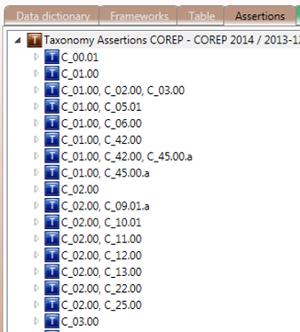
Assertions
Listed by the table(s) they affect.

Slide 60
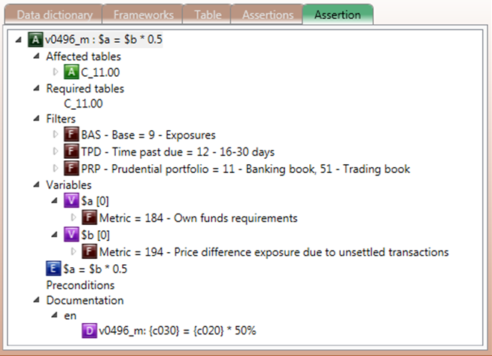
Details of Formulae

Slide 61
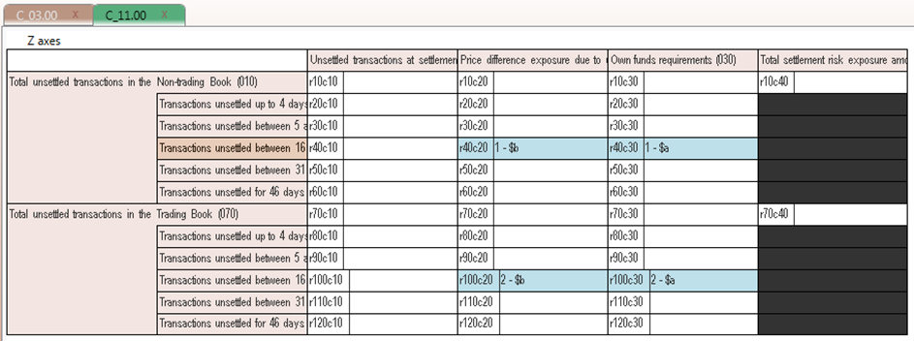
Details of Formulae - evaluations

Slide 62
How might an CA use the tool?
To Tweak
E.g. labelling changes, keeping the same underlying data
Fairly simple - just define a new “Owner” for the labels & add them.
Publish either the new files or new entry points that include them
To Complement
E.g. additional tables alongside the EBA ones
Maybe redo remnant bits of current reporting that are not replaced by CRD IV in a consistent format
Easy to define new forms using the same base dictionary (with additions).
Makes clear the points of similarity/divergence with CRD IV data.

Slide 63
How might an CA use the tool?
NSAs contemplating this kind of work should talk to Victor Morilla of the Banca de España about the tool.
Can also talk to the EBA about our experience of using the tool.
We think it might be ideal for
smaller projects,
with little existing tooling,
And some, but limited, XBRL expertise
For projects involving co-ordinating large numbers of experts,
or for authorities with lots of prior knowledge or investments, there may be other suitable approaches (in which DPM Architect may play a part).

Slide 64
Owen Jones
owen.jones@eba.europa.eu

