Slide 1
New COREP/FINREP experiences
Carlos Martins
5 May 2014| Rome
19th Eurofiling Workshop

Slide 2
DPM statistics
COREP/FINREP

Slide 3
Template groups

Slide 4
Taxonomies

Slide 5
Report Types
COREP
Taxonomy entry points are based on these report types, with two variants: for solo/consolidated scope (COREP), or IFRS/GAAP (FINREP)

Slide 6
Templates with open axis
Open Axis | Framework | Template Group | Dimensions | #Templates | #DataPoints
Z i.e. multiple sheets | FINREP | FINREP part 2 | Country of counterparty | 4 | 157
 | COREP | Credit Risk | Country of exposure | 4 | 413
 |  | Liquidity Coverage | Currency | 4 | 3.534
 |  | Stable Funding | Currency | 2 | 3.004
Y i.e. repeatable rows | FINREP | FINREP part 4 | Legal entity | 1 | 19
 |  |  | Legal entity * Security | 1 | 6
 | COREP | Credit Risk | Obligor grade | 2 | 533
 |  |  | Securitisation | 1 | 48
 |  | Group Solvency | Legal entity | 1 | 48
 |  | Large Exposures | Client | 3 | 64
 |  |  | Group of clients * Client | 2 | 58

Slide 7
Data points definition
COREP/FINREP

Slide 8


Defining complex reporting concepts
Small seeds
Green
?
Size M
“Firm rounded edible fruit of a rosaceous tree, Malus sieversii, native to Central Asia but widely cultivated in temperate regions in many varieties, having pink or white fragrant flowers.”
Edible skin

Slide 9
Changing dimensional properties
Juicy
Small seeds
Green
Size M
Edible skin
Round shape

Slide 10

Assigning unique IDs
Juicy
Small seeds
Green
Size M
Edible skin
Round shape

Slide 11
Reporting platform
COREP/FINREP

Slide 12
Reporting platform – services
Metadata services
Collection
services
Validation
services
Integration services
Exploration
services
Notification
services
Monitoring services
Quality
services
Dissemination
services
Master data services
Reference data services

Slide 13
Reporting platform – data stores
Metadata
Reference Data
Data Warehouse
Master Data
File Archive
Data Staging Area
Data Marts
Data Marts
Data Marts
Data Marts

Slide 14
Data integration
COREP/FINREP

Slide 15
Data validation and integration
Data validation
Data integration
XBRL instances
Technical validation
Valid instances
Data extraction
Data tranformation & loading
Bespoke development
Off-the-shelf solution
XBRL taxonomy
Staging area
Data Warehouse
Formulae validation
Data Mart
XBRL taxonomy
Error logging
Data marting
Data Mart
Validation reports
Data Mart
Data Mart
Data Point Model
Reference data
Master data

Slide 16
DPM database: Data Point definition
Table | C 28.00 - Exposures in the non-trading and trading book
Column | Xbrl Context Key | Metric | DataPoint VID | Dimension Label | Member Label
020 | INC=* | ei319 | 85161 | Individual clients | <Key value>
040 | BAS=eba_BA:x9,INC=*,MCY=eba_MC:x59 | mi180 | 85024 | Base | Exposures
 |  |  |  | Individual clients | <Key value>
 |  |  |  | Main category | Debt instruments, Equity instruments, Derivatives, Off balance sheet instruments
050 | BAS=eba_BA:x9,IMS=eba_IM:x3,INC=*,MCY=eba_MC:x59 | mi180 | 85023 | Base | Exposures
 |  |  |  | Impairment status | Defaulted
 |  |  |  | Individual clients | <Key value>
 |  |  |  | Main category | Debt instruments, Equity instruments, Derivatives, Off balance sheet instruments
060 | BAS=eba_BA:x9,INC=*,MCY=eba_MC:x223 | mi180 | 85025 | Base | Exposures
 |  |  |  | Individual clients | <Key value>
 |  |  |  | Main category | Debt securities, Loans and advances
070 | BAS=eba_BA:x9,INC=*,MCY=eba_MC:x130 | mi180 | 85027 | Base | Exposures
 |  |  |  | Individual clients | <Key value>
 |  |  |  | Main category | Equity instruments
080 | BAS=eba_BA:x9,INC=*,MCY=eba_MC:x99 | mi180 | 85026 | Base | Exposures
 |  |  |  | Individual clients | <Key value>
 |  |  |  | Main category | Derivatives
090 | BAS=eba_BA:x9,INC=*,MCY=eba_MC:x221 | mi180 | 85029 | Base | Exposures
 |  |  |  | Individual clients | <Key value>
 |  |  |  | Main category | Loan commitments given

Slide 17
XBRL instance: Data Fact definition
<xbrli:context id="c8">
  <xbrli:entity>
  <xbrli:identifier scheme="http://something">LEIIDENTIFIERFORTEST</xbrli:identifier>
  </xbrli:entity>
  <xbrli:period>
  <xbrli:instant>2013-12-31</xbrli:instant>
  </xbrli:period>
  <xbrli:scenario>
  <xbrldi:explicitMember dimension="eba_dim:BAS">eba_BA:x9</xbrldi:explicitMember>
  <xbrldi:explicitMember dimension="eba_dim:IMS">eba_IM:x3</xbrldi:explicitMember>
  <xbrldi:typedMember dimension="eba_dim:INC">
  <eba_typ:CC>CLIENTCODE</eba_typ:CC>
  </xbrldi:typedMember>
  <xbrldi:explicitMember dimension="eba_dim:MCY">eba_MC:x59</xbrldi:explicitMember>
  </xbrli:scenario>
</xbrli:context>
<eba:mi180 contextRef="c8" unitRef="U-EUR" decimals="-3">777777.77</eba:mi180>

Slide 18
XBRL instance: Data Fact definition
<xbrli:context id="c8">
  <xbrli:entity>
  <xbrli:identifier scheme="http://something">LEIIDENTIFIERFORTEST</xbrli:identifier>
  </xbrli:entity>
  <xbrli:period>
  <xbrli:instant>2013-12-31</xbrli:instant>
  </xbrli:period>
  <xbrli:scenario>
  <xbrldi:explicitMember dimension="eba_dim:BAS">eba_BA:x9</xbrldi:explicitMember>
  <xbrldi:explicitMember dimension="eba_dim:IMS">eba_IM:x3</xbrldi:explicitMember>
  <xbrldi:typedMember dimension="eba_dim:INC">
  <eba_typ:CC>CLIENTCODE</eba_typ:CC>
  </xbrldi:typedMember>
  <xbrldi:explicitMember dimension="eba_dim:MCY">eba_MC:x59</xbrldi:explicitMember>
  </xbrli:scenario>
</xbrli:context>
<eba:mi180 contextRef="c8" unitRef="U-EUR" decimals="-3">777777.77</eba:mi180>

Slide 19
XBRL instance: Data Fact definition
<xbrli:context id="c8">
  <xbrli:entity>
  <xbrli:identifier scheme="http://something">LEIIDENTIFIERFORTEST</xbrli:identifier>
  </xbrli:entity>
  <xbrli:period>
  <xbrli:instant>2013-12-31</xbrli:instant>
  </xbrli:period>
  <xbrli:scenario>
  <xbrldi:explicitMember dimension="eba_dim:BAS">eba_BA:x9</xbrldi:explicitMember>
  <xbrldi:explicitMember dimension="eba_dim:IMS">eba_IM:x3</xbrldi:explicitMember>
  <xbrldi:typedMember dimension="eba_dim:INC">
  <eba_typ:CC>CLIENTCODE</eba_typ:CC>
  </xbrldi:typedMember>
  <xbrldi:explicitMember dimension="eba_dim:MCY">eba_MC:x59</xbrldi:explicitMember>
  </xbrli:scenario>
</xbrli:context>
<eba:mi180 contextRef="c8" unitRef="U-EUR" decimals="-3">777777.77</eba:mi180>
Instance
global
dimensions
Context
specific
dimensions
Key Value
Fact Value
Metric
Units

Slide 20
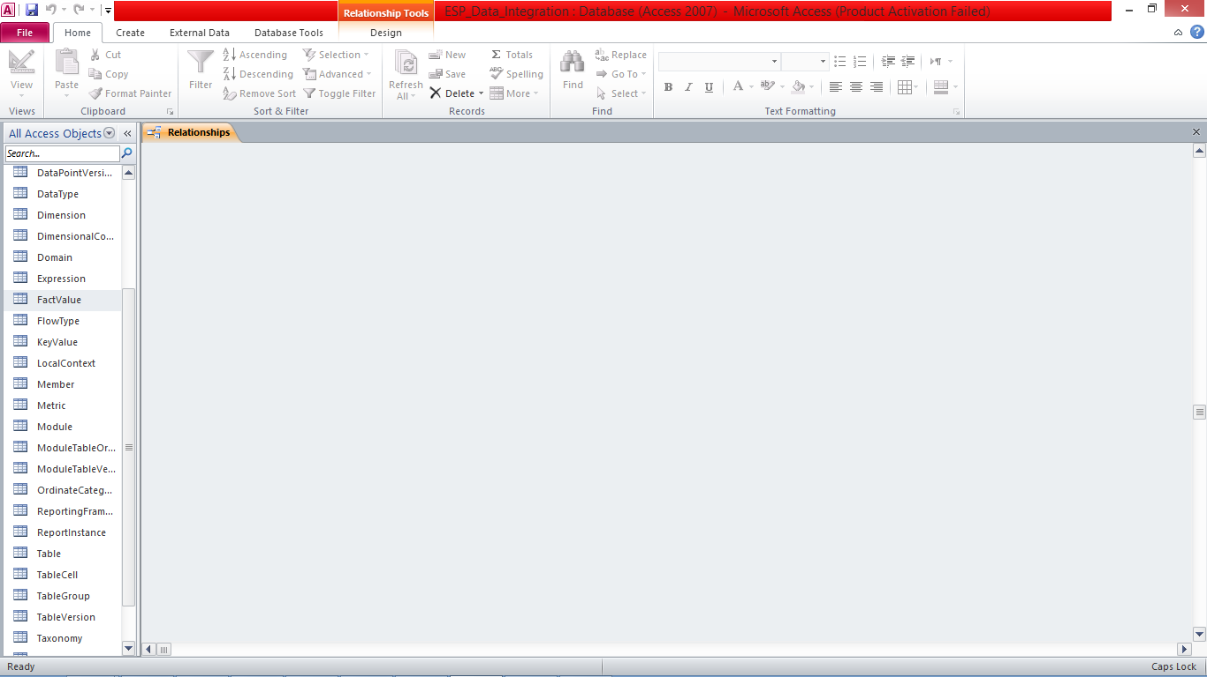
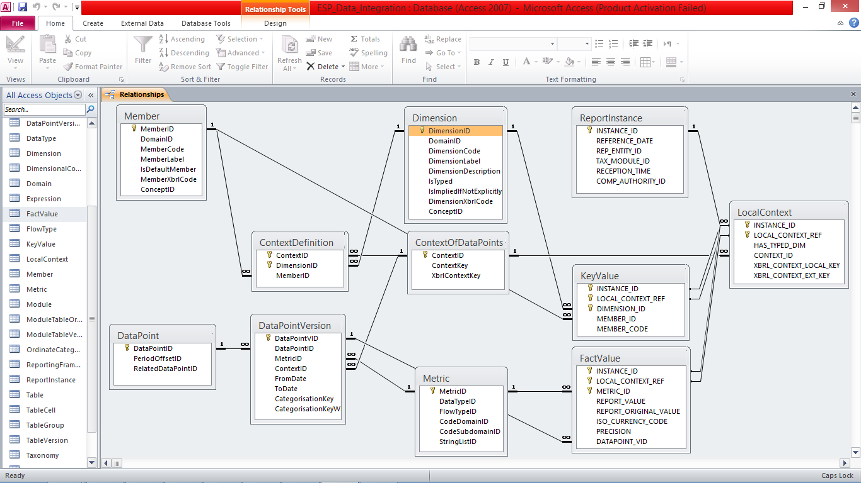
Data extraction: shredding the XBRL instances
Staging
Area
DPM

Slide 21
Mapping XBRL to the DPM
For each instance local context, e.g. “c8”
  Read the scenario to find the dimensional definition:
    Dimension BAS Explicit Member eba_BA:x9
    Dimension IMS Explicit Member eba_IM:x3
    Dimension INC Typed Member CLIENTCODE
    Dimension MCY Explicit Member eba_MC:x59
  Build the XBRL Context Local Key, by concatenating the pairs Dimension=Member in alphabetic order:
  BAS=eba_BA:x9,IMS=eba_IM:x3,INC=*,MCY=eba_MC:x59
    Note: typed members (e.g.“CLIENTCODE”) are not defined in the DPM, thus they must be replaced by an “*”
  Find the same string in the DPM table.column ContextOfDataPoints.XBRLContextKey and get the value of the ContextID “44617”

Slide 22
Mapping XBRL to the DPM
Search the file for Metrics that reference the local context “c8” and
  take note of the related values
    Metric “mi180” Unit "EUR" Decimals "-3“ Fact Value “777777.77”
  Find “mi180” in DPM table.column Member.MerberCode and get MemberID “1353”, which is also Metric.Metric
  With both MetricID “mi180” and ContextID “44617”, search the DPM table DataPointVersion to find the DataPointID “85023”
For this instance, append each of the the staging area tables, LocalContex, FactValue, and KeyValue, with a new record, containing the related reported values and DPM IDs

Slide 23
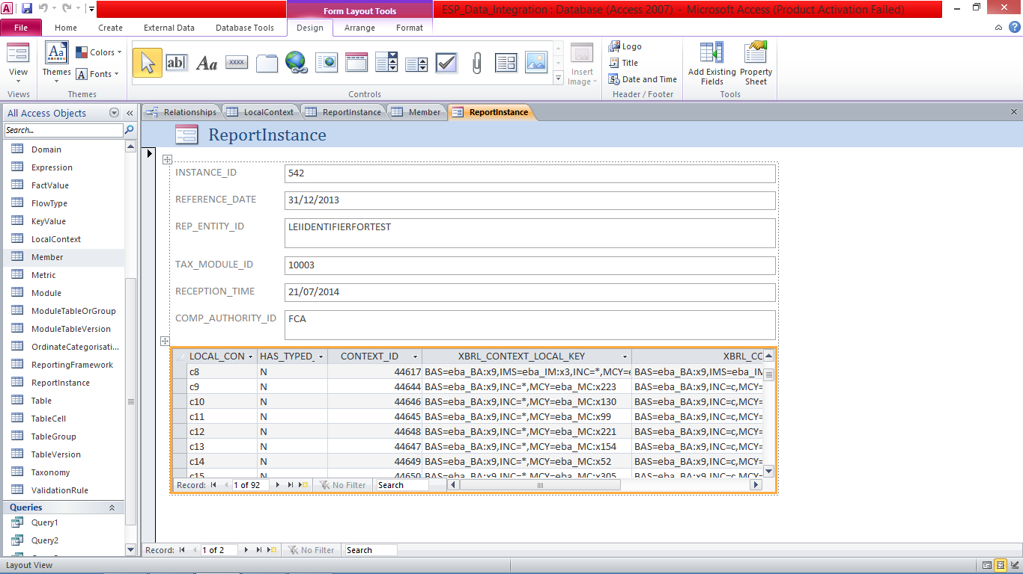
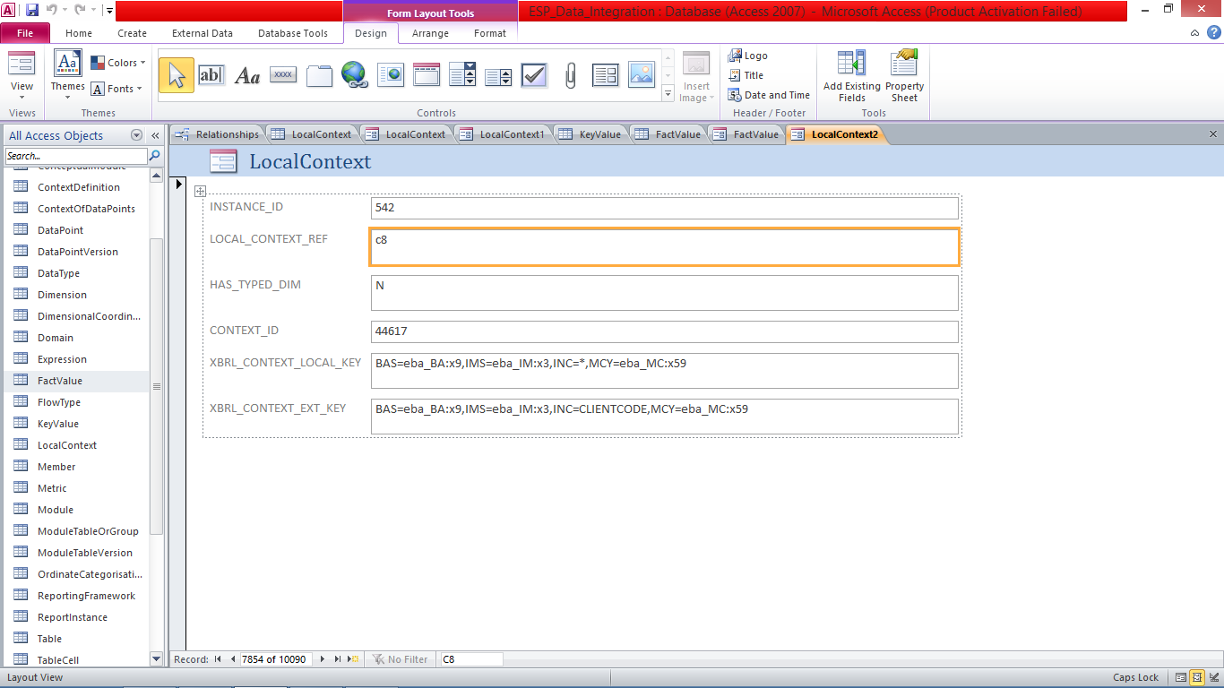
Extracted data: the relational format

Slide 24
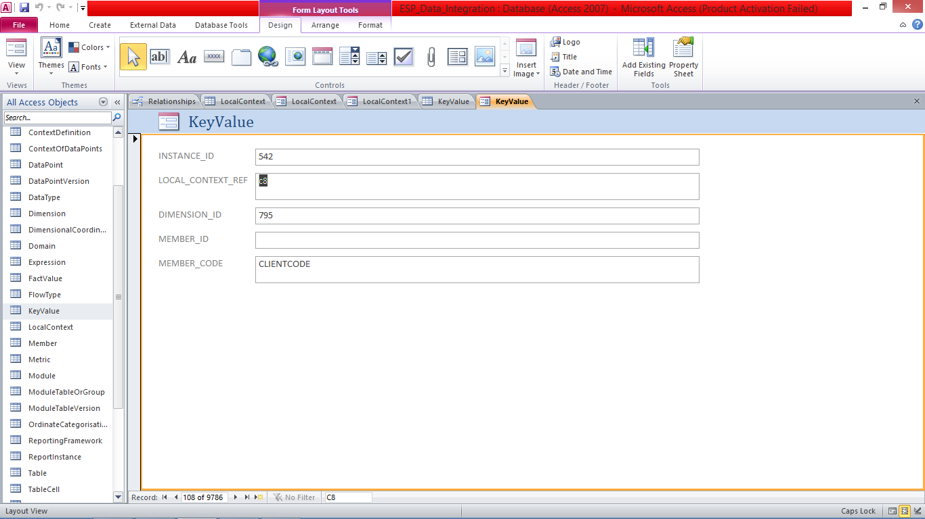
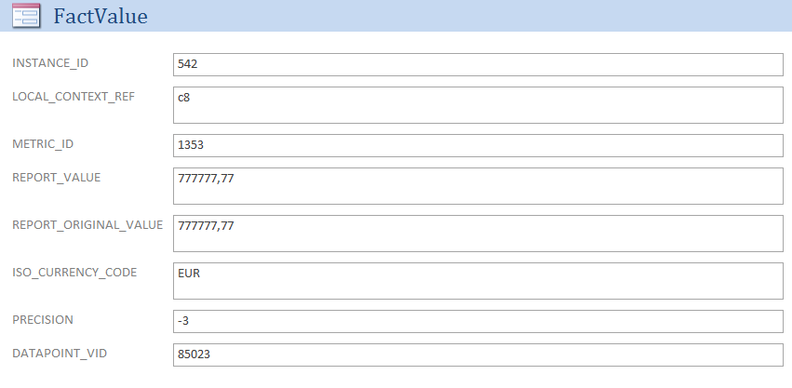
Extracted data: the relational format

Slide 25
Questions?
COREP/FINREP

