Slide 1
The IFRS Taxonomy – update
Rita Ogun-Clijmans – Senior Technical Manager

Slide 2
Agenda
Developments in the last 12 months and what is next
Interaction with standard setting
The IFRS Taxonomy Due Process
The IFRS Taxonomy jurisdictional profiles

Slide 3
Developments in the last 12 months and what is next

Slide 4
Developments in the last 12 months
IFRSs – general hedge accounting, rate regulation …
Common Practice – real estate, telecommunications
Documentation – to describe meaning of elements
Due process – public consultation on taxonomy updates during the year
Modularisation – new namespace and folders for full IFRS, IFRS for SMEs and Management Commentary
Notes:
.

Slide 5
And continuing to improve
Content Development
Focus areas for 2014
Upcoming new or amended IFRSs are expected to have a significant impact
Common practice for seven new activities
  retail, pharmaceuticals and transport
  media, technology, chemicals and utilities
Due Process
Jurisdictional profiles
The data model for IFRSs – initiation stage
Interaction with standard setting
Notes:
.

Slide 6
IFRSs impacting IFRS Taxonomy in 2014
IASB Final Standards
Topic | IASB due process stage | Date planned | Impact
Rate-regulated activities | IFRS published |  | significant
Revenue recognition | Target IFRS | Q2 2014 | significant
Classification and measurement (IFRS 7 & IFRS 9) | Target IFRS | H1 2014 | limited to significant
Impairment | Target IFRS | H1 2014 | significant

Slide 7
IFRSs impacting IFRS Taxonomy in 2014
IASB Final Standards (if final IFRS in 2014)
Topic | IASB due process stage | Timing | Impact
IFRS for SMEs review | ED comment period | ended 3 March 2014 | significant
Annual Improvements 2012–2014 | ED comment period | ended 13 March 2014 | limited
Leases | Redeliberations |  | significant
Insurance contracts | Redeliberations |  | significant
Macro hedge accounting | Discussion Paper | Q2 2014 | significant

Slide 8
Interaction with standard setting

Slide 9
A new organisation structure …
Disclosure Initiative
Implementation
Amendments to IAS 1
Research
Principles of Disclosure
Review of existing Standards
Ongoing activities
Digital reporting
New EDs
Reconciliation of liabilities from financing activities
Materiality

Slide 10
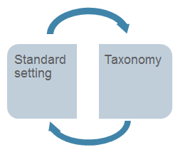
… resulting in tangible benefits
Standard setting and the IFRS Taxonomy can inform each other
For example
Support to technical staff - clarity, logic and consistency of language in IFRS
Principles of Disclosures – impact of technology

Slide 11
The IFRS Taxonomy Due Process

Slide 12
Background
A project to review the Due Process Handbook for XBRL Activities was initiated mid 2012 – the focus areas are:
  New advisory structure
  Content accessibility: new public consultation document
  Timing: timing to align to the due process followed for standard setting
    Stage 1 - interim taxonomy releases for final IFRs
    Stage 2 – interim taxonomy releases for IFRS ED (proposal)
  IASB engagement: review of the taxonomy (proposal)
More details about the proposal can be found at http://www.ifrs.org/DPOC/meetings/Documents/April%202014/AP3E%28i%29_DPOC_TaxonomyDP.pdf

Slide 13
Governance
Technical guidance
IFRS Taxonomy Consultative Group (ITCG)
Oversight
Trustees DPOC
Approval
IASB
Strategic guidance
IFRS Advisory Council
Proposal
Public Consultation

Slide 14
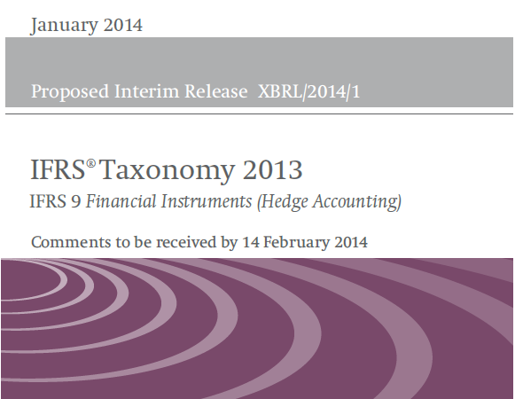
Proposed IFRS Taxonomy Update – cover page

Slide 15
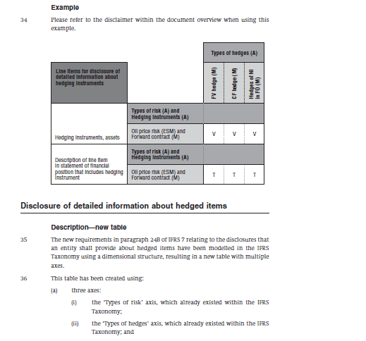
Proposed IFRS Taxonomy Update – content (example)

Slide 16
The IFRS Taxonomy Jurisdictional Profiles
Notes:
Olivier

Slide 17
IFRS Taxonomy jurisdictional profiles
Objectives
about 30 different regulatory frameworks in 36 countries are now implementing the IFRS taxonomy
to make publicly available on the website IFRS Taxonomy jurisdictional profiles
  bringing clarity to who is using the IFRS taxonomy and how they are using it
  providing information to investors about available IFRS instances
  additionally, to increase the team’s awareness of any challenges that still may exist when adopting the taxonomy
Based on IFRS Jurisdiction profiles - http://www.ifrs.org/Use-around-the-world/Pages/Jurisdiction-profiles.aspx

Slide 18
IFRS Taxonomy jurisdictional profiles
Approach and stages
Questionnaire Design
Limited trial
Questionnaire updates
Regional
/Focussed roll out
Continued roll out in batches
Q2 2014
Q3/Q4 2014
Based on surveys sent to individual organisations with or considering electronic filing requirements
Each response will be reviewed and may be followed up with other questions
Publication of first profiles targeted for Q1 2015

Slide 19

Questions or comments?
Expressions of individual views
by members of the IASB and
its staff are encouraged. The views expressed in this presentation
are those of the presenter.
Official positions of the IASB on accounting matters are determined only after extensive due process and deliberation.
Notes:
19

Slide 20

Thank you

